Slide 1
A Survey on User Modeling in HCI
Presented by:
Mohammad Sajib Al Seraj
Supervised by:
Prof. Robert Pastel

Slide 2
User Modeling
Representation of the knowledge and preferences of users
Customization and adaptation systems to the user's specific needs
Internal representation of the user
Not a mandatory part of the software
It helps to get the system serve the user better

Slide 3
Scope and Application
Functionality Coverage
Execution time
Help systems
Notes:
Functionality Coverage
If the designer has a list of likely user goals, GOMS models can be used to verify that a method exists to achieve each of these goals.
Execution time
GOMS models can predict the time it will take for the user to carry out a goal (assuming an expert user with no mistakes). This allows a designer to profile an application to locate bottlenecks, as well as compare different UI designs to determine which one allows users to execute tasks quicker.
Help systems
Since GOMS models are an explicit representation of expert user activity, they can assist in designing help systems and tutorials to assist users in achieving goals.

Slide 4
Classification
GOMS
Cognitive Architectures
Grammar-based models
Application Specific Models

Slide 5
The GOMS family of models
GOMS (Goals, Operators, Method and Selection)
GOMS like models need a precise description of how the user will behave
Different GOMS
KLM-GOMS
CMN-GOMS
NGOMSL
CPMGOMS

Slide 6
Keystroke Level Model (KLM)
K =0.2 sec keystroking/ keypressing
P =1.1 sec pointing with a mouse to a target
H =0.4 sec homing the hand on the keyboard
M =1.35sec performing mental preparation
R =? waiting for the computer to execute a command
Notes:
the researchers attempted to determine typical values:
K = 0.2 sec Keying: The time to perform a keystroke, or mouse click
P = 1.1 sec Pointing: The time to position the mouse pointer
H = 0.4 sec Homing: The time for user to move hands from keyboard to mouse
M = 1.35 sec Mental: The time for the user to prepare for the next step
R = ? Responding: The time for the computer to respond to the user inputs.

Slide 7
Keystroke Level-Model Rules
Rule 0: Initial insertion of candidate Ms: Insert M before all Ks and Ps
Rule 1: Deletion of anticipated Ms: If P or K is fully anticipated by a preceding P or K then delete the middle M. For example moving the mouse to tap on the button; PMK => PK
Rule 2: Deletion of Ms in cognitive units: If a series of Ks represent a string then delete the middle Ms; for example type ‘1.2’ is a cognitive unit; MKMKMK => MKKK
Rule 3: Deletion of Ms before consecutive terminators: If several delimiters are typed only keep the first M. For example if ‘))’ is the terminator, use only one M.
Rule 4: Deletion of Ms that are terminators of commands: If the terminator is a frequently used, delete the M before the terminator; for example a command followed by “return,” so the M before the K representing the “return” is deleted. But if the terminator delimits arguments for a command string that vary then keep the M. This represents checking that the arguments are correct.
Rule 5: Deletion of overlapped Ms: Do not count any portion of an M that overlaps with a command response. (This is the reason that a responsive interface only needs to respond in a second.)

Slide 8
Keystroke Level-Model Demonstration
Keystroke Level-Model Demonstration
Notes:
https://www.youtube.com/watch?v=yJLaqYzk55E

Slide 9
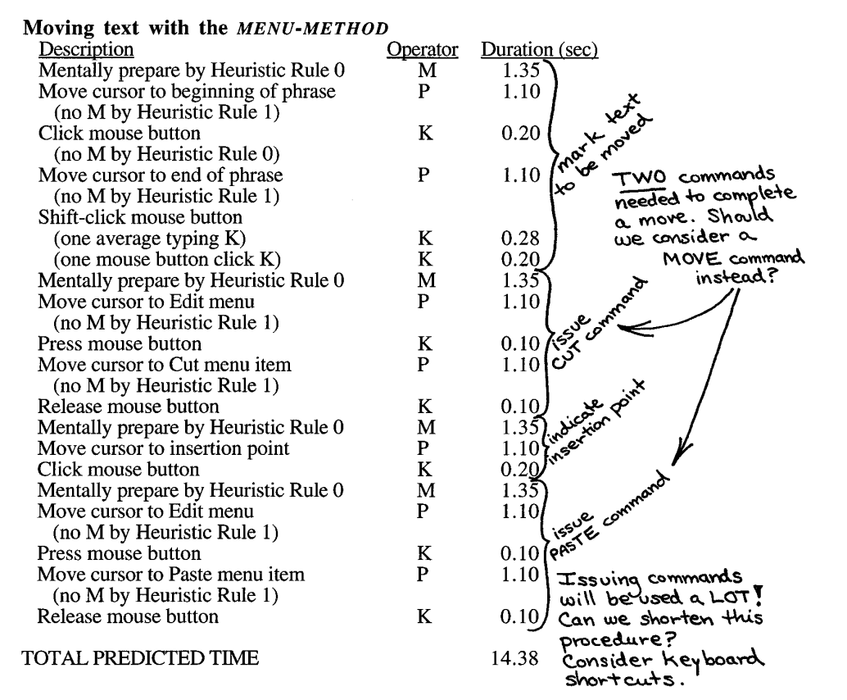
Keystroke Level-Model Example
Notes:
http://www.cs.umd.edu/class/fall2002/cmsc838s/tichi/printer/goms.html

Slide 10
CMN-GOMS
Based on KLM
Add sub-goal and selection rules
Example
GOAL: EDIT-MANUSCRIPT
. GOAL: EDIT-UNIT-TASK ... repeat until no more unit tasks
. . GOAL: ACQUIRE UNIT-TASK
. . . GOAL: GET-NEXT-PAGE ... if at end of manuscript page
. . . GOAL: GET-FROM-MANUSCRIPT
. . GOAL: EXECUTE-UNIT-TASK ... if a unit task was found
. . . GOAL: MODIFY-TEXT
. . . . [select: GOAL: MOVE-TEXT* ...if text is to be moved
. . . . GOAL: DELETE-PHRASE ...if a phrase is to be deleted
. . . . GOAL: INSERT-WORD] ... if a word is to be inserted
. . . . VERIFY-EDIT

Slide 11
NGOMSL
Builds on CMN-GOMS by providing a natural-language notion
Example
Method for goal: Highlight arbitrary text
Step 1. Determine position of beginning of text (1.20 sec)
Step 2. Move cursor to beginning of text (1.10 sec)
Step 3. Click mouse button. (0.20 sec)
Step 4. Move cursor to end of text. (1.10 sec)
Step 5. Shift-click mouse button. (0.48 sec)
Step 6. Verify that correct text is highlighted (1.20 sec)
Step 7. Return with goal accomplished.

Slide 12
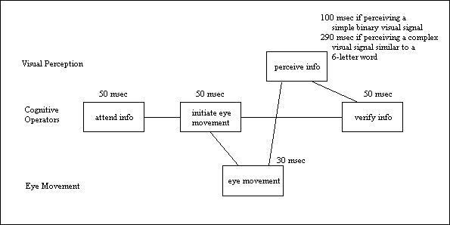
CPM-GOMS
Explore the parallelism in users’ actions

Slide 13
Limitations of GOMS
Does not account for nonskilled users
Does not account for learning and recall
Does not account for errors
Little distinction between cognitive processes
Does not address mental workload
Does not address functionality
Does not address user fatigue
Does not account for individual differences
Does not account for user’s acceptance
Does not address organizational life

Slide 14
Cognitive Architectures
Designed to simulate human intelligence in a human like way
Different Cognitive Architecture
Soar architecture
ACT-R system
EPIC (Executive-Process/Interactive Control) architecture
CORE system
Notes:
Soar Architecture based on chunking mechanism
Chunking mechanism: a way of converting goal-based problem solving into accessible long-term memory (productions)
ACT-R operates as a rule based system. It divides the long-term memory into declarative and procedural memory.

Slide 15
Grammar-based models
Simulates an interaction in the form of grammatical rules
Example
Task Action Language models
Operations by Terminal symbols
Interaction by a Set of rules
Knowledge by Sentences

Slide 16
Future Challenges
Support different modeling techniques
Payoff of user modeling
Wrong, outdated, and inadequate information
Criteria for different domains
Privacy

Slide 17
References
Benyon D., Murray D (August 1993)., Applying User Modeling to Human Computer Interaction Design, Artificial Intelligence Review, Volume 7, Numbers 3-4, pp. 199 – 225.
Perrault C. R., Allen J. F., & Cohen P. R. (1978). Speech Acts As a Basis for Understanding Dialogue Coherence, In Proceedings of the 1978 Workshop on Theoretical Issues in Natural Language Processing (pp. 125–132). Stroudsburg, PA, USA: Association for Computational Linguistics. doi:10.3115/980262.980282.
Cohen P. R., & Perrault C. R. (1979). Elements of a plan-based theory of speech acts, Cognitive Science, 3(3), 177–212. doi:10.1016/S0364-0213(79)80006-3
Rich, E. (1979a). Building and exploiting user models. In Proceedings of the 6th international joint conference on Artificial intelligence-Volume 2, pp. 720–722.
Rich, E. (1979b). User modeling via stereotypes*. Cognitive Science, 3(4), 329–354.
Moran T.P. (1981) Command Language Grammar: A Representation For The User Interface of Interactive Computer Systems, International Journal of Man-Machine Studies 15.1, pp. 3-50.

Slide 18
Thanks

