Slide 1
Usability Test Results - Roya Survey
Mohammad Sajib Al Seraj

Slide 2
Roya Survey
Aims to aid coffee farmers and scientists in identifying and tracking the outbreak of La Roya Fungus.
Collected data will be used to improve current and future models predicting outbreaks of La Roya.

Slide 3
Test Process
Module based testing
Different module
Login
New Submission
Analyze the previously upload issue and Comment
About

Slide 4
Collected data during the testing
Quantitative data
Time to run a test
The number of times users find the task difficult and ask test coordinators for help
Qualitative data
Facial expression of user while testing
Comments by user
User’s attention in the application
Comfort of user
Bug
Number of bugs
Occurrence types
Bug module

Slide 5
Test Results
Quantitative data
Average 7minutes to complete a test
User ask 3times to coordinator for help
Qualitative data
Positive facial expression during testing
Positive comments by user
User’s attention in the application was good
Average users were comfortable during testing
Bug
Total: 11
Major issue: 4
Minor issue: 7

Slide 6
Summary of bugs
Major issue:
No message after providing incorrect credential
No Save or Done option after giving leaf input
Edit or delete option unavailable
Logout option unavailable
Minor issue
Find me option is not working for android phone
After giving partial information, its not possible to save as a submission
Alignment problem in capture option
No option for taking picture from storage in android phone
Sorting option is not available
Unable to login from firefox
Cant resume after network error

Slide 7
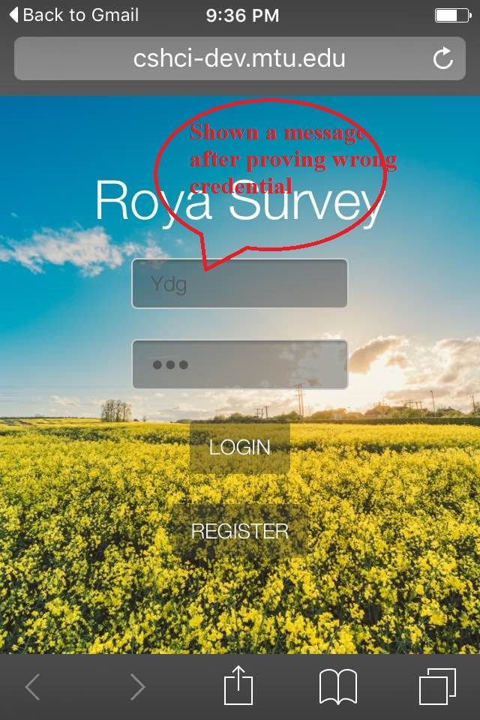
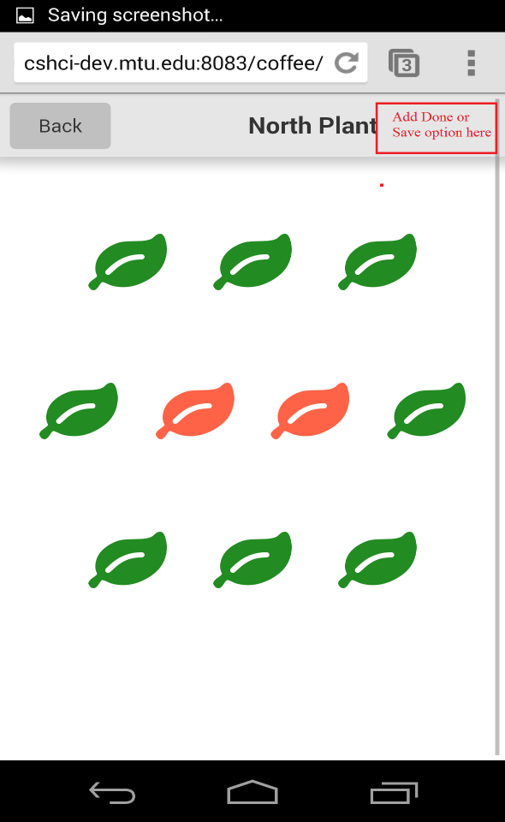
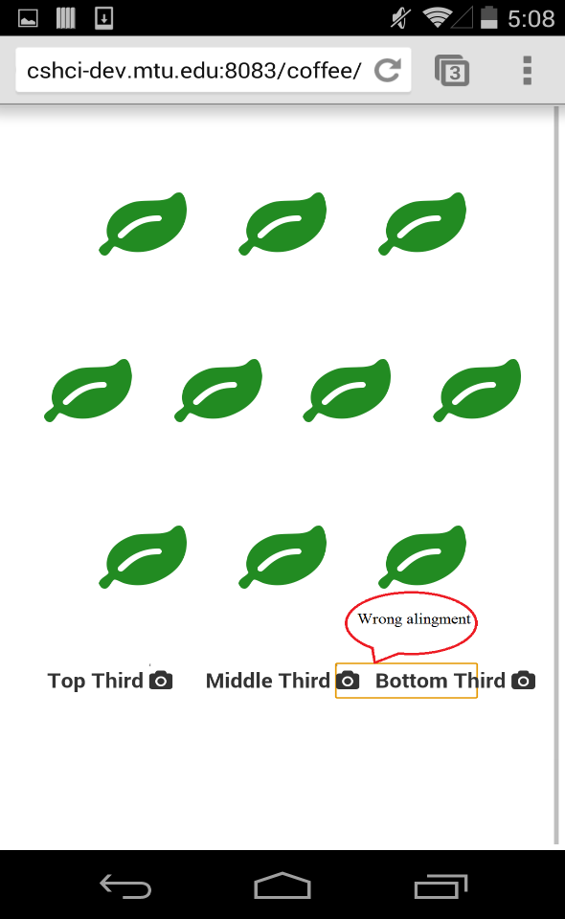
Recommend changes
Showing Message after providing incorrect credential
Adding Save or Done option after giving leaf input
Correct alignment

Slide 8
Recommend changes
Showing Message after providing incorrect credential
Adding Save or Done option after giving leaf input
Adding Logout option
Adding edit and delete option

Slide 9
Thanks

