Slide 1
The Psychology of User Choices
Briana Bettin CS5760 – March 14th, 2017

Slide 2
Persistence | Perception | Perspective | Sociability | Value
Toward Goals and Tasks | of Information Given | of Situations and Task | toward community members | of artefact in question
Zeigarnik Effect | Barnum Effect | Duning-Kruger Effect | Bystander Effect | Perceived Scarcity
Endowed Progress Effect | Halo/Horns Effect | Pygmalion/Rosenthal Effect | Online Disinhibition Effect | IKEA Effect
Near Miss Effect | Focusing Effect | Functional Fixedness | Halo/Horns Effect | Paradox of Choice
 | Cocktail Effect |  | Cocktail Effect
Persistence: Ensures a user continues toward the desired outcome.
Perception: Allows information processing by user toward better outcomes.
Perspective: Recognizes obstacles toward outcome in user so they can be overcome.
Sociability: Communication concepts in users so outcomes can be achieved.
Value: Explores importance to user so they commit to outcomes.

Slide 3
Persistence

Slide 4
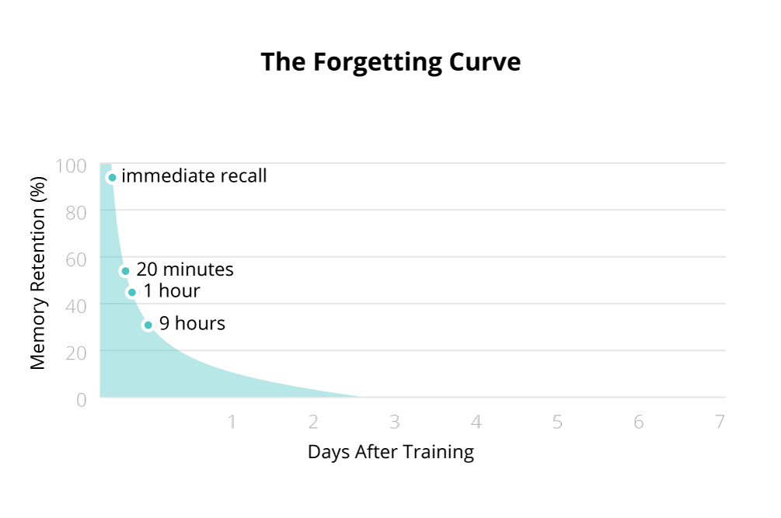
The Zeigarnik Effect
Interrupting a task causes it to be remembered more strongly.
When we complete something, we feel we are done and can begin forgetting.
HCI Application: During tutorials of major processes, shift learning to small subtasks as “breaks” from the main task that are still relevant, but interruptive.
Image retrieved from http://www.bizlibrary.com/wp-content/uploads/2016/03/retention-charts.png
Dilbert, Image retrieved from http://lerablog.org/wp-content/uploads/2014/06/Interruptions.jpg

Slide 5
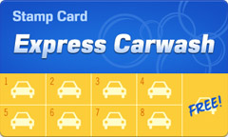
Endowed Progress Effect
When users feel progress has been made toward a goal, they feel they must continue to completion.
HCI Application: Through training and sign up for a system, show the user how they’ve already begun the journey toward a desired goal with a “checklist” or similar system.
Image retrieved from http://www.remembergroup.com/wp-content/uploads/2013/07/8.jpg
Image retrieved from http://www.gameifications.com/wp-content/uploads/2013/03/Endowed_progress_effect.jpg

Slide 6
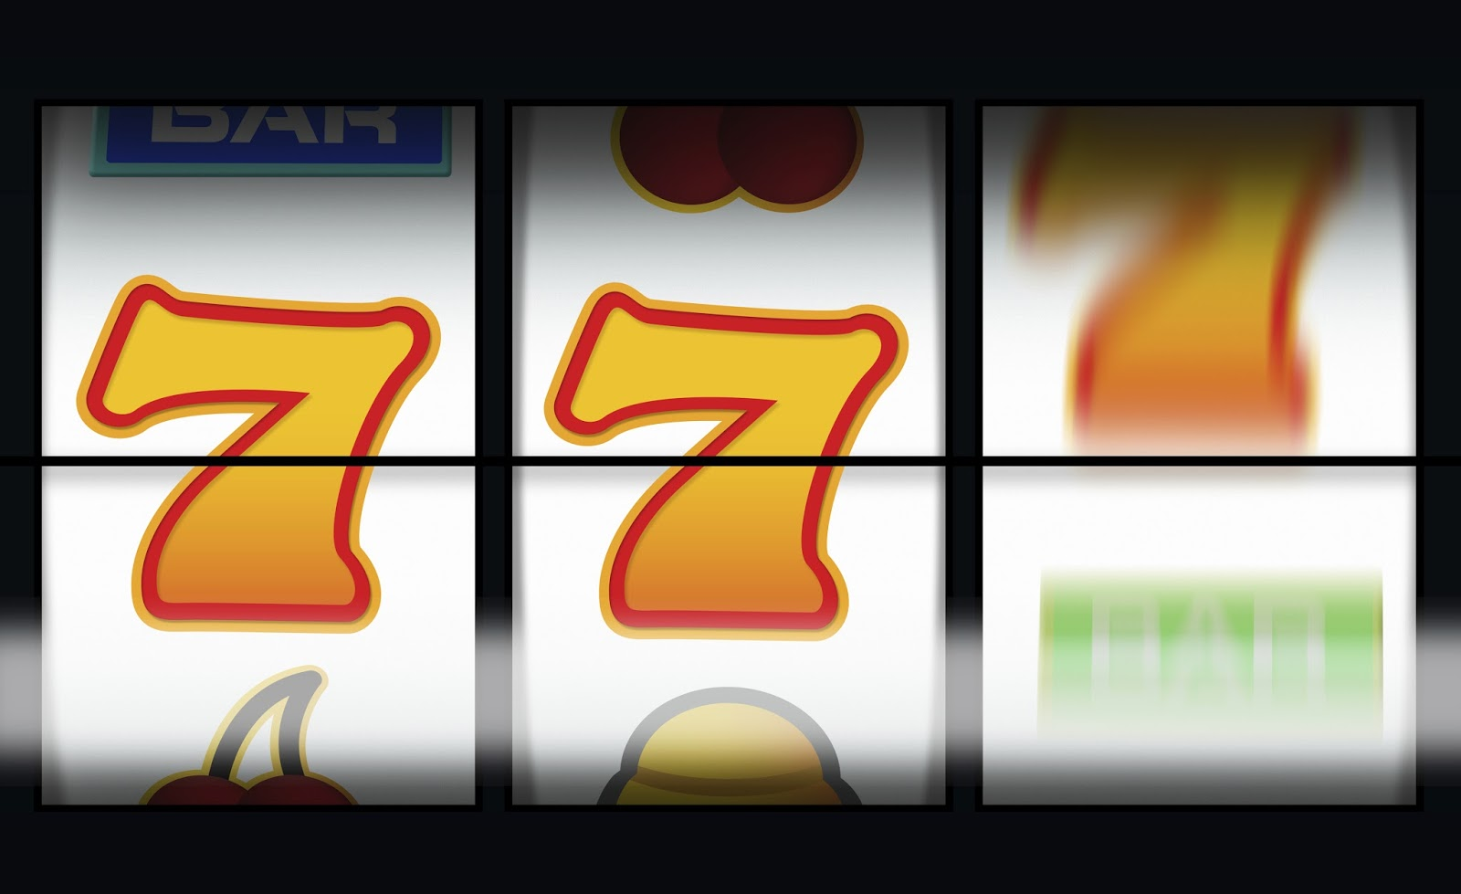
Near Miss Effect
The human brain equates a very close “almost” as thrilling in a nearly similar way to a success.
HCI Application: Showing users, especially in an applied skill test that can be retaken, how close they came to success can encourage users to try again
Image retrieved from http://4.bp.blogspot.com/-8UKeqHl3czU/VdRGqKVrmSI/AAAAAAAACWc/OsTKmdhPi6c/s1600/near%2Bwin.jpg
Image retrieved from http://3.bp.blogspot.com/-JQc3lYCeZQ4/UwtAFgyUW_I/AAAAAAAAAII/uTMPrKLELxc/s1600/AlmostWinning_coverart.jpg

Slide 7
Perception

Slide 8
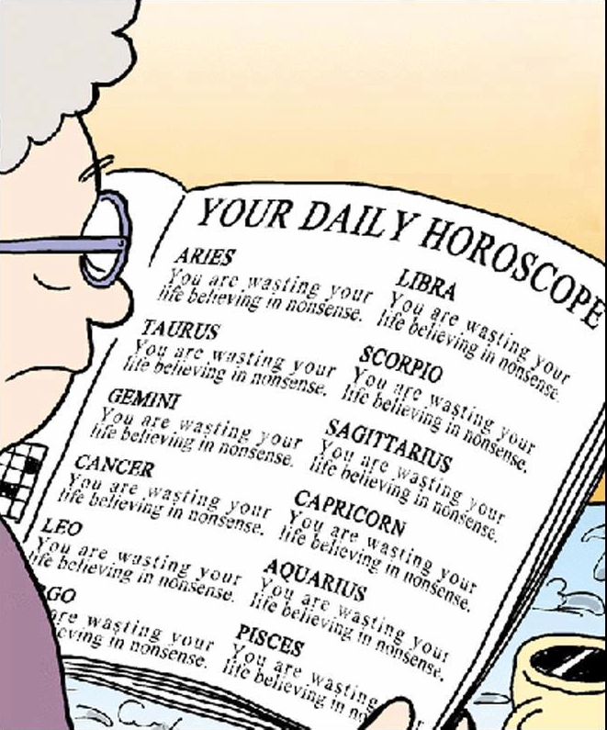
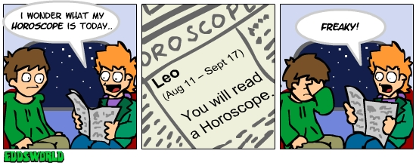
The Barnum Effect
Humans readily identify with vague descriptions if they believe they are personalized.
HCI Application: Fostering comradery with users via an understanding of the “general” user’s likely feelings.
Can be a double edged sword: context destroys some value of the Barnum Effect, and can seem insincere if “seen through”
Image retrieved from https://classicallyeducated.files.wordpress.com/2015/01/astrology-cartoon.png
Image retrieved from http://orig02.deviantart.net/a456/f/2008/011/0/4/ewcomics_no__12___horroscope_by_eddsworld.jpg

Slide 9
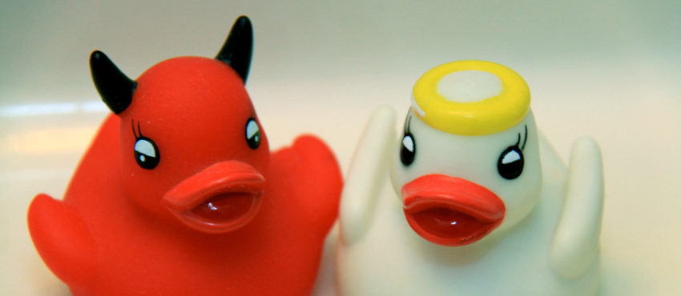
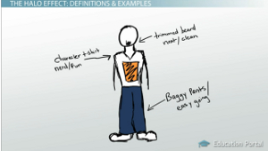
The Halo/Horns Effect
If one considers something (or someone) very good or bad in a specific area, this can “spill over” into perception of other areas.
HCI Application: Ensuring users gain a good first impression of your system through marketing, a great feature, reviews, etc. can make up for potential flaws or lacking features.
Image retrieved from http://www.bizpenguin.com/wp-content/uploads/2014/12/horn-and-halo.jpg
Image retrieved from http://study.com/cimages/multimages/16/halo-effect-clothing-example.jpg

Slide 10
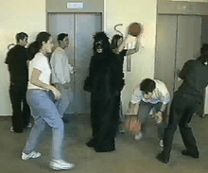
Focusing Effect
Users often anchor most heavily on the first piece of information they are given, or a specific salient piece of information to them, no matter its actual value.
HCI Application: The most important takeaway for a user on any given screen should be some of the first information given as well as some of the most visually apparent.
Image retrieved from https://img.buzzfeed.com/buzzfeed-static/static/2014-03/enhanced/webdr08/15/13/enhanced-29526-1394904030-4.jpg
Image retrieved from http://blog.wfmu.org/freeform/images/opaque_gorilla_1.jpg

Slide 11
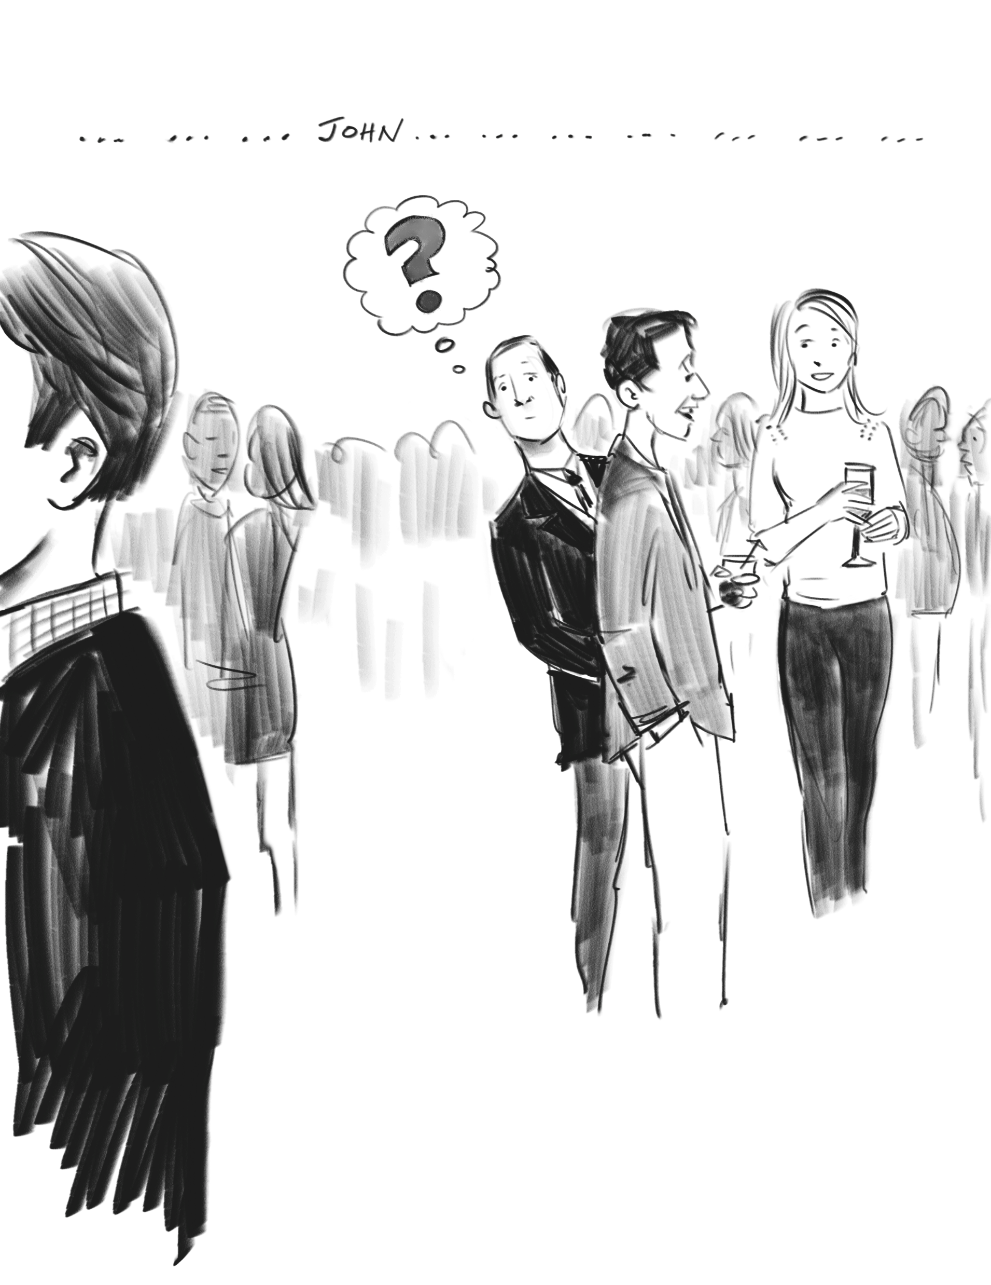
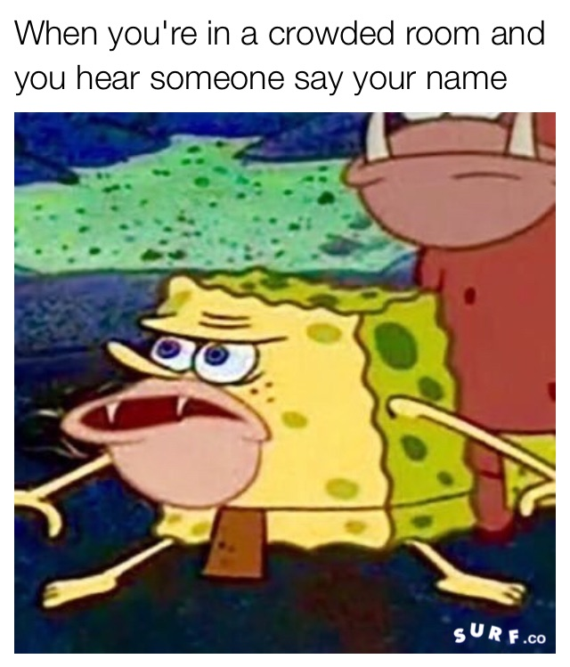
Cocktail Effect
The ability to focus on a specific train of information and filter out all other “noise” while still recognizing valid salient cues, such as our own name.
HCI Application: Notification icons and pop over messages, or a user’s name can grab their information even as they filter out menu options, advertisements, etc. that are “noise”
Image retrieved from http://www.edtech.engineering.utoronto.ca/sites/default/files/Item%2076%20Cocktail%20Party%20Effect.png
Image retrieved from https://d1sui4xqepm0ps.cloudfront.net/when-youre-in-a-crowded-r-1.jpg

Slide 12
Perspective

Slide 13
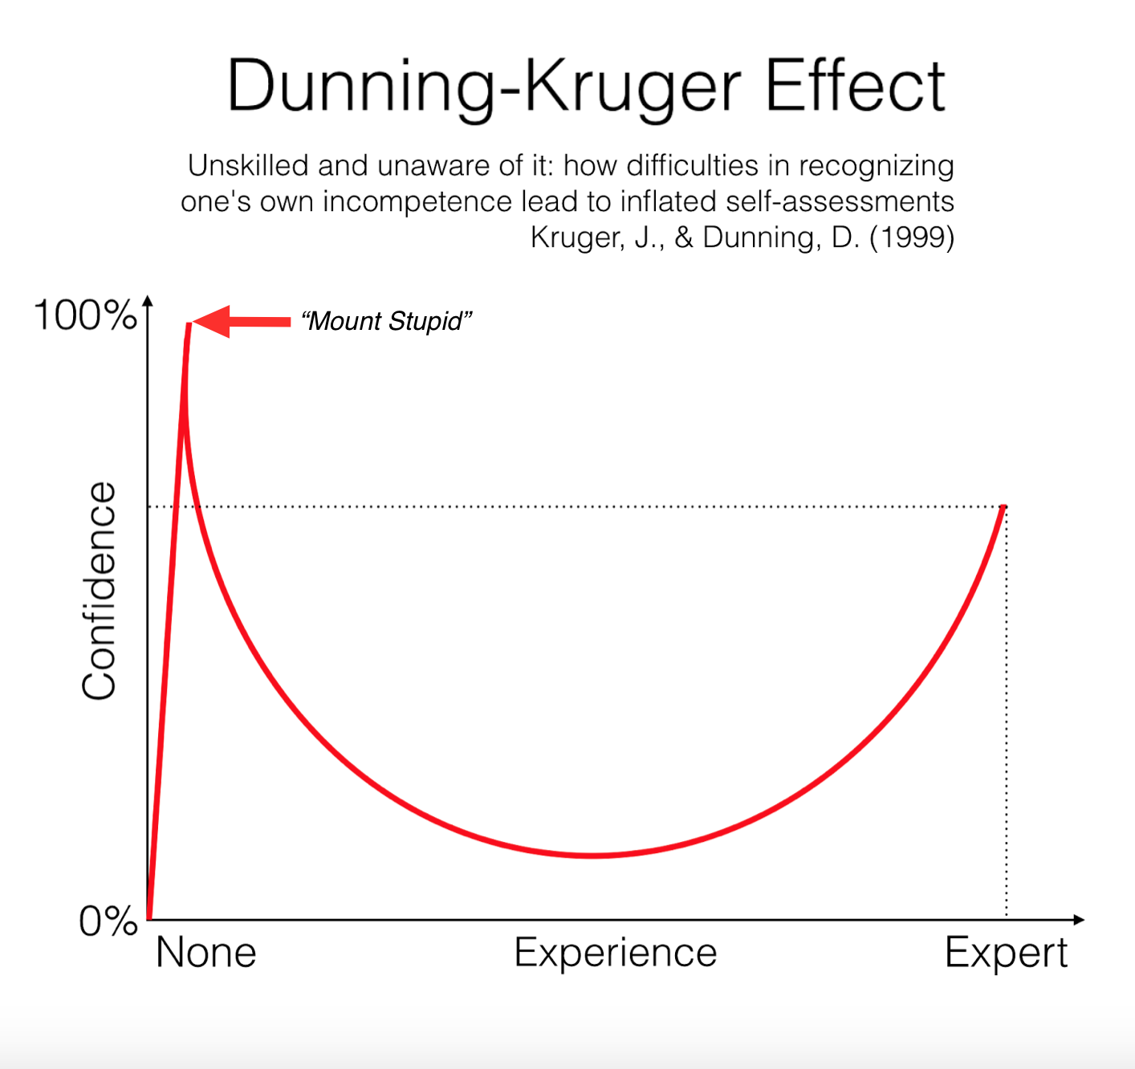
The Dunning-Kruger Effect
Unskilled users may lack the cognitive resources to realize they lack skill, and believe they are in fact experts.
HCI Application: Buffers, tips, and corrective nudges that relate to the user’s actual level of shown skill in the system can help “corral” users and place them on the proper path to success
Image retrieved from http://spikedmath.com/comics/314-the-dunning-kruger-effect-2.png
Image retrieved from http://karenpendergrass.com/wp-content/uploads/2016/03/karen-Pendergrass-paleo-journey.png

Slide 14
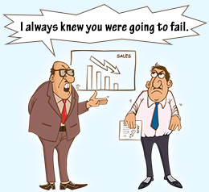
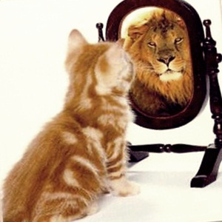
Pygmalion/Rosenthal Effect
“Self fulfilling prophecy” – positive or negative stigmas are often internalized, and actions are performed better or worse accordingly.
HCI Application: When users fail often, congratulating them on partial completion or “near misses” can help internalize success and push them away from negative feelings.
Image retrieved from https://vimvipabusayaraungrat.files.wordpress.com/2015/04/594881-32024-15.jpg
Image retrieved from http://4.bp.blogspot.com/-DAKbNznCIEM/UGMZs50ORhI/AAAAAAAAAKA/JSmpL-WPNs0/s1600/cat1%5B1%5D.jpg

Slide 15
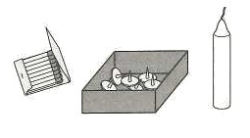
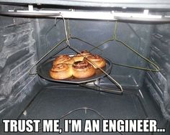
Functional Fixedness
Users often perceive only a limited pool of traditional actions for something, rather than “thinking outside the box”
HCI Application: Adhere to traditional actions whenever possible to avoid user confusion. When breaking traditions, do so with purpose, and make it clear what is being broken and why.
Image retrieved from http://www.futilitycloset.com/wp-content/uploads/2012/04/2012-04-19-the-candle-problem-1.jpg
Image retrieved from https://s-media-cache-ak0.pinimg.com/236x/da/55/11/da5511aa324d507f054a6069167be6ab.jpg

Slide 16
Sociability

Slide 17
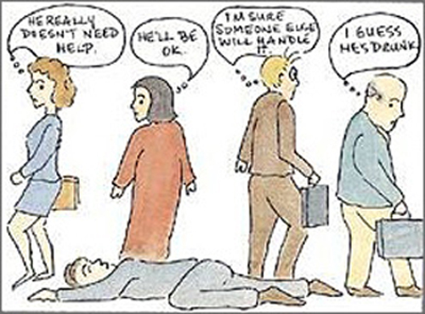
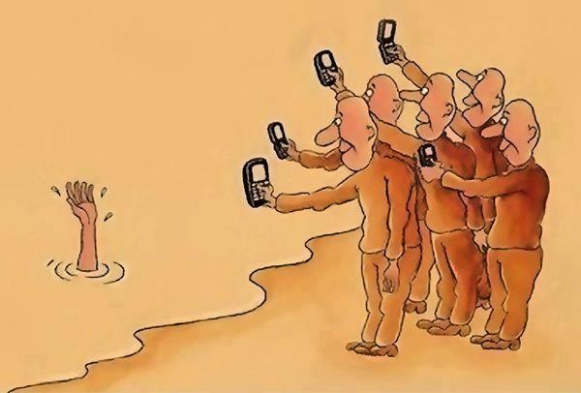
Bystander Effect
As the number of people present in a situation increases, the likelihood of action being taken decreases.
HCI Application: In systems where critical incidents can be reported, reminding users to take action can help. Recognizing they may not however must be further considered and mitigated by designers.
Image retrieved from https://sonnemann.files.wordpress.com/2012/04/bystandereffect.jpg
Image retrieved from https://s-media-cache-ak0.pinimg.com/originals/60/e6/58/60e658af3a194b6760fff12a87e7302d.jpg

Slide 18
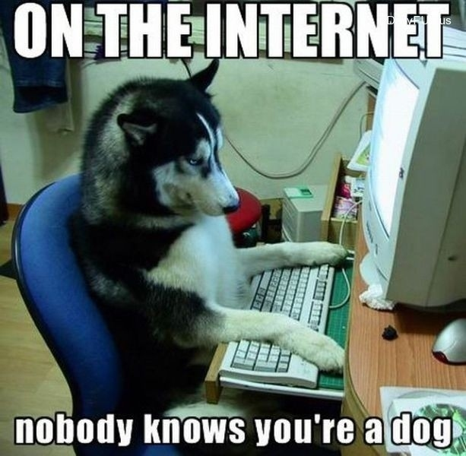
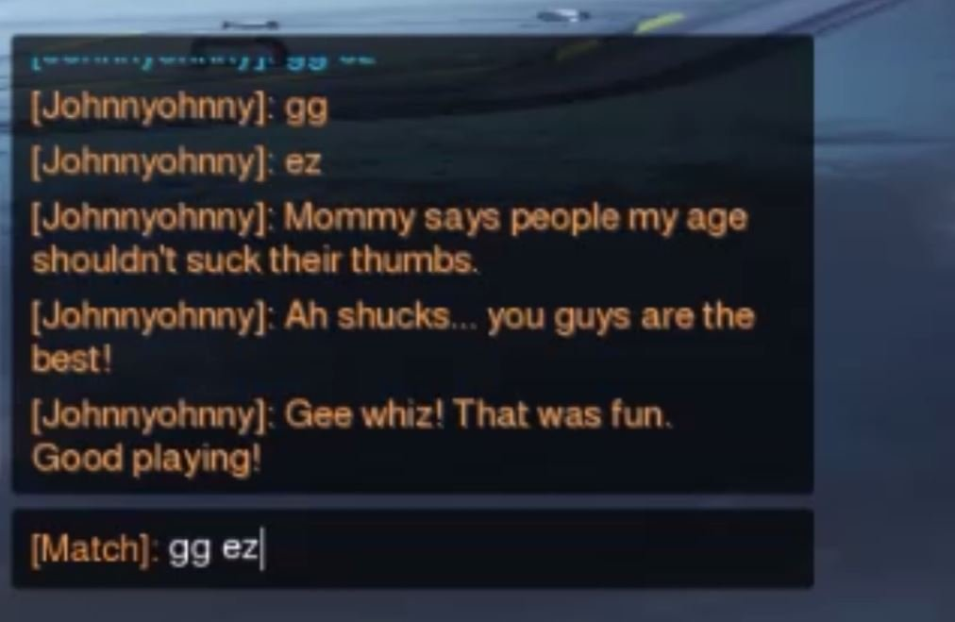
Online Disinhibition Effect
Users may act as a less restricted version of themselves online, for better or worse. Their behaviors are not inherently indicative of their “real world” social presence.
HCI Application: Ensuring there are consequences for acting in a way unfitting a social community may help realign users who would exhibit negative disinhibition. Options for users on the receiving end of these effects are also important.
Image retrieved from https://fordhamcyberculture.files.wordpress.com/2014/03/74219-on-the-internet-nobody-knows-y-15ol1.jpeg
Image retrieved from http://1.media.dorkly.cvcdn.com/32/57/b03b730ca9e7797b257d137f05cdc7c6.jpg

Slide 19
Value

Slide 20
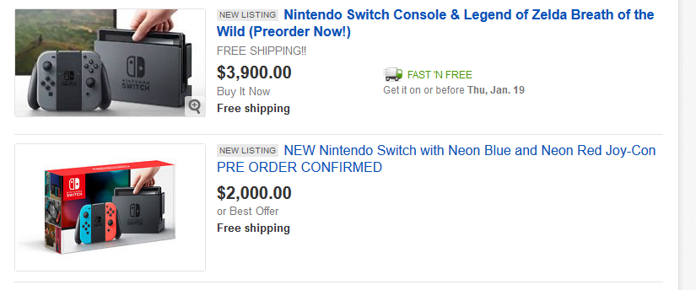
Perceived Scarcity
If users believe something is rare, they are more likely to pursue it, and more likely to place high value on it whether they obtain it or not.
HCI Application: Users may switch to a better version of a product more readily if it is perceived as a limited offer, or may purchase a premium account for special benefits in a limited quantity.
Image retrieved from http://hardmoneybankers.com/wp-content/uploads/2013/04/limited-time-only.png
Image retrieved from https://www.nintendoprime.net/wp-content/uploads/2017/01/eBaySwitch.png

Slide 21
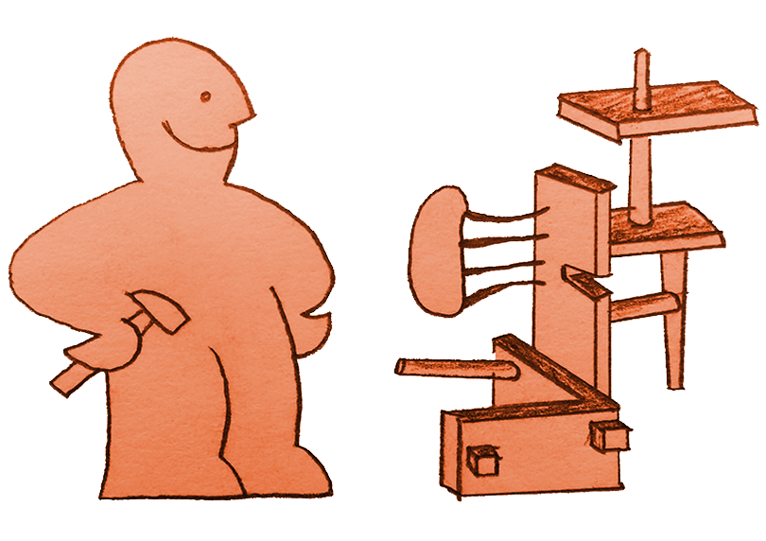
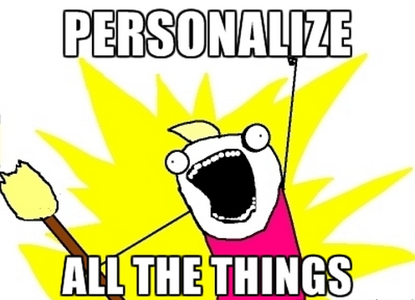
IKEA Effect
Users are more likely to place value in something if they had a hand in making it, regardless of the actual quality.
HCI Application: Personalization details, or ways users can otherwise “build” aspects of their profile, the community, or customize their settings can cause users to view a system more fondly.
Image retrieved from http://wearevolcanic.com/wp-content/uploads/2014/11/ikea4.png
Image retrieved from http://cdn2.business2community.com/wp-content/uploads/2014/10/Personalize_All_the_Things_meme.png.png

Slide 22
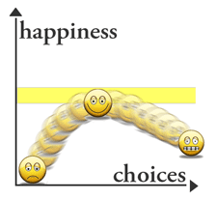
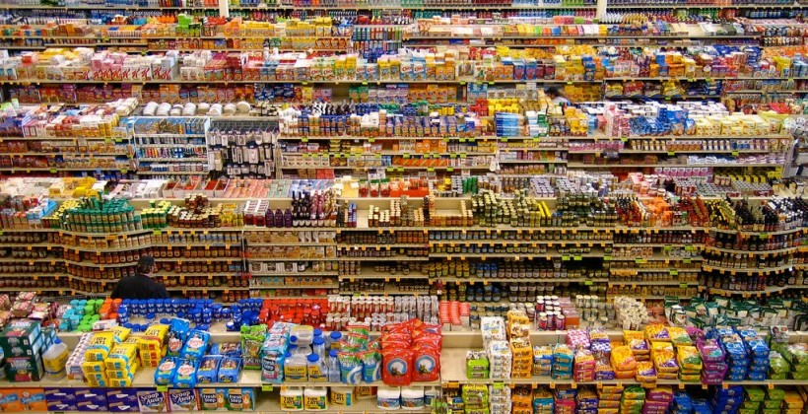
The Paradox of Choice
Users desire the freedom to make choices, but too many choices causes one to feel overwhelmed and can cause frustration and unhappiness.
HCI Application: Present users with a few good options. If more detail is needed, allow users to “drill down” by making one small choice, then another small choice, etc. rather than one huge one.
Image retrieved from https://otrazhenie.files.wordpress.com/2013/08/choice_paradox1.gif
Image retrieved from http://www.yusp.com/wp-content/uploads/2015/08/supermarket-paradox-of-choice.jpg

Slide 23
Questions? ☺
Thank you for your time!

Slide 24
REFERENCES
Adamson, R.E. (1952). "Functional Fixedness as related to problem solving: A repetition of three experiments". Journal of Experimental Psychology, 44, 288-291
Atkinson, J.W. (1953). The achievement motive and recall of interrupted and completed tasks. Journal of Experimental Psychology. 46(6). 381-390
Baumeister, R.F., & Bushman, B.J., (2008, Revised 2010). Social Psychology and Human Nature (Second Edition), 109, 123. Cengage Learning. Retrieved from https://books.google.com/books?id=pTw4IMrOg0sC&printsec=frontcover#v=onepage&q&f=false
Bronkhorst, Adelbert W. (2000). "The Cocktail Party Phenomenon: A Review on Speech Intelligibility in Multiple-Talker Conditions" (pdf). Acta Acustica united with Acustica. 86: 117–128.
Darley, J. M. & Latané, B. (1968). "Bystander intervention in emergencies: Diffusion of responsibility". Journal of Personality and Social Psychology. 8: 377–383. doi:10.1037/h0025589
Forer, B. R. (1949). The fallacy of personal validation: A classroom demonstration of gullibility. Journal of Abnormal and Social Psychology, 44, 118-123.
Heimbach, J.T. and Jacoby, J. (1972). The Zeigarnik Effect in Advertising. Proceedings of the Third Annual Conference of the Association of Consumer Research. 746-758.
Kruger, Justin; Dunning, David (1999). "Unskilled and Unaware of It: How Difficulties in Recognizing One's Own Incompetence Lead to Inflated Self-Assessments". Journal of Personality and Social Psychology. 77 (6): 1121–34. CiteSeerX 10.1.1.64.2655Freely accessible. doi:10.1037/0022-3514.77.6.1121. PMID 10626367.
Nisbett, Richard E; Wilson, Timothy D (1977). "The halo effect: Evidence for unconscious alteration of judgments". Journal of Personality and Social Psychology. American Psychological Association. 35 (4): 250–56. doi:10.1037/0022-3514.35.4.250
Norton, Michael I.; Mochon, Daniel; Ariely, Dan (2012). "The IKEA effect: When labor leads to love" (PDF). Journal of Consumer Psychology. 22 (3): 453–460. doi:10.1016/j.jcps.2011.08.002
Nunes, J. C., & Drze, X. (2006). The Endowed Progress Effect: How Artificial Advancement Increases Effort. Journal of Consumer Research, Vol.32(4), 504-512. Retrieved from http://eds.a.ebscohost.com.proxy.lib.iastate.edu/ehost/detail/detail?sid=a289ba50-378b-48ad-9914-e176c790b8d9%40sessionmgr4004&vid=0&hid=4110&bdata=JnNpdGU9ZWhvc3QtbGl2ZQ%3d%3d#AN=20373879&db=ufh
Reid, R.L. (1986). The Psychology of the Near Miss. Journal of Gambling Behavior, 2, 32-39.
Rosenthal, R.; Jacobson, L. (1968). Pygmalion in the Classroom. New York: Holt, Rinehart & Winston.
Schwartz, Barry. 2004. The paradox of choice: why more is less. New York: Ecco.
Strack, Fritz; Mussweiler, Thomas (1997). "Explaining the enigmatic anchoring effect: Mechanisms of selective accessibility.". Journal of Personality and Social Psychology. 73 (3): 437–446. doi:10.1037/0022-3514.73.3.437.
Suler, John (2004). "The Online Disinhibition Effect". CyberPsychology & Behavior. 7 (3): 321–326. doi:10.1089/1094931041291295.
Tobacyk, Jerome; Milford, Gary; Springer, Thomas; Tobacyk, Zofia (June 10, 2010). "Paranormal Beliefs and the Barnum Effect". Journal of Personality Assessment: 737–739.
Weiner, B., Johnson, P., Mehrabian, A., Wayne H. (1968). Journal of Educational Psychology, Vol. 59(3), 181-185. Retrieved from http://psycnet.apa.org.proxy.lib.iastate.edu/journals/edu/59/3/181
Worchel, S., Lee, J., Adewole, A. L., & John T. (1975). Effects of supply and demand on ratings of object value. Journal of Personality and Social Psychology, Vol.32(5), 906-914. doi:10.1037/0022-3514.32.5.906
Zeigarnik, B. (1967). On finished and unfinished tasks. In W. D. Ellis (Ed.), A sourcebook of Gestalt psychology, New York: Humanities press.

