Slide 1
Sentiment Analysis on Interactive Conversational Agent/Chatbots
Sameena Thabassum
sthabass@mtu.edu

Slide 2
What is a Interactive Conversational Agent/Chatbot?
Chatbots are the interactive conversational agents. They reply a user via auditory or textual methods.
Apple’s SIRI, Windows CORTANA are common chatbots used now a days.
ELIZA and PARRY are classic historic chatbots.

Slide 3
What is Sentiment Analysis
Sentiment Analysis refers to the process of computationally identifying and categorizing opinions expressed in a piece of text, especially in order to determine whether the writer's attitude towards a particular topic, product, etc., is positive, negative, or neutral

Slide 4
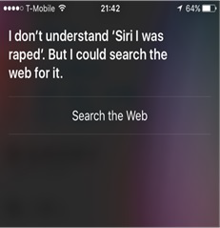
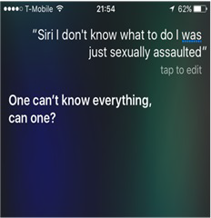
Why Sentiment Analysis on Chatbots
Recent studies have proved that Chatbots like SIRI failed to empathy in case of rape or sexual assault related questions.
Images by Sara Wachter-Boettcher via Medium

Slide 5
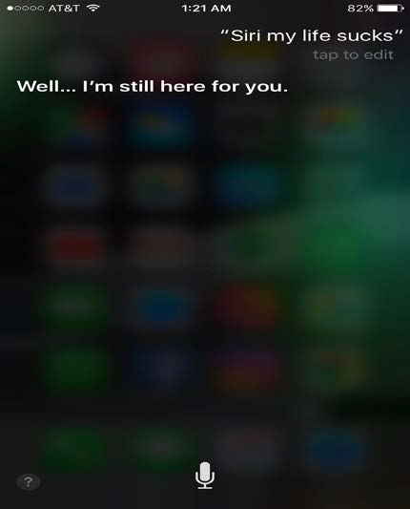
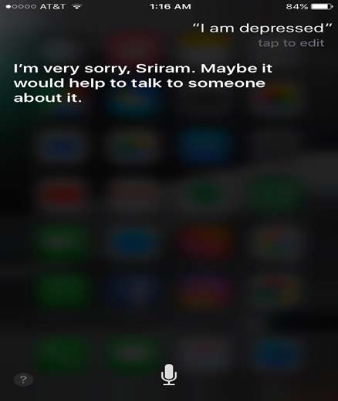
Recent Updates of SIRI has learned to respond to such queries

Slide 6
Why Sentiment Analysis on Chatbots
Imagine a case where , a person experiences heart stroke and tells SIRI about it.
At such times we don’t want a “I did not get you ” reply from SIRI.
Not just SIRI but most of the smart phone AI’s like CORTANA, S Voice, Google Now failed in showing compassion.
It would be great if these agents can refer users to helplines

Slide 7
Why Sentiment Analysis on Chatbots
When Chatbot is capable of understanding the sentiment of user, then he/she can comfortably interact with the Chatbot.
If a Chatbot is able to show gratitude to the user or apologize when the user is not pleased with the reply, then conversation becomes more natural and human like.

Slide 8
Why Sentiment Analysis on Chatbots
This can be used for data mining purposes also. Chat logs can be used to know what displeased a user and what fascinates a user. This can help a lot to improve customer services.
Using Sentiment Analysis, a new mode of understanding the user’s interactions will become available.

Slide 9
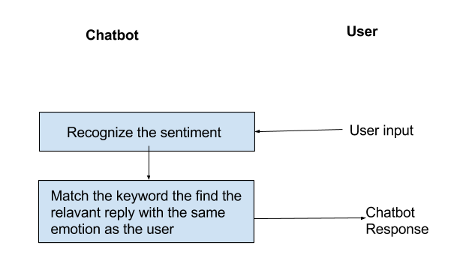
Basic structure of a Chatbot with sentiment analysis

Slide 10
Recognizing Emotion
This process of recognizing sentiment is explained in the paper Sentiment Analysis to Improve Emotional Health of User
Pre-processing
Training dataset, is classified into positive or negative. We can use Naïve Bayes classifier based on Supervised Learning.
Cleaning the Data
Before classifying the data, we need to remove unnecessary content from the data. Like hash tags and @usernames, Emoticons

Slide 11
Recognizing Emotion
Bag of Words (BOW)
Lists of all the words present in the tweets both negative and positive are maintained.
N-grams
N-grams are an ordered set of words with length n. N-grams are used handle negations , adverbs and adjectives
Negation Handling
A major issue faced during the task of sentiment classification is that of handling negations. It uses ‘!’ symbol to represent words following not. Thus not good is represented as ‘!good’.

Slide 12
Recent Work
Koko App
Koko is a start-up that has been working on developing empathic Chatbot.
MIT’s Media Lab. has launched Koko in 2014.
Koko with the partnership with Kik, an emotional tune up service, became an iPhone app that one could reach at any time with a simple text as well.
Koko has released a demo of Alexa when it was plugged into amazon platform.

Slide 14
Sarcasmbots
Sarcasmbots are an open-source sarcasm generation module for chatbots designed by students of IIT Bombay
This bots give a sarcastic reply for any user input. This Bots have three components in them, one input Analyser, two Generator Selector and three Sarcasm Generator.

Slide 15
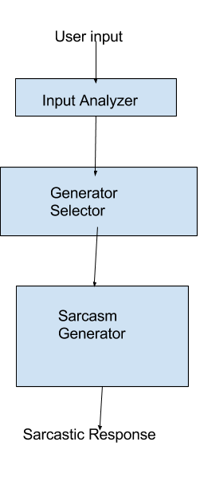
The Sarcasmbots has eight Sarcasm generators, Offensive Word Response Generator, opposite Polarity Verb-situation Generator, Opposite Polarity person–attribute generator, Irrealis sarcasm generator, hyperbole generator, incongruent reason generator, sentiment –based sarcasm generator, random Response generator. The Generator selector decides on which sarcasm generator to select basing on some criteria in the input.

Slide 16
Failure of TAY.AI:
TayBot is a Chatbot designed by Microsoft. It was designed to behave like 19-year-old American teenager. TAY means “Thinking About You”.
It was supposed to learn from the twitter conversations.
Tay was launched on March23, 2016 with the user name @TayandYou.

Slide 17
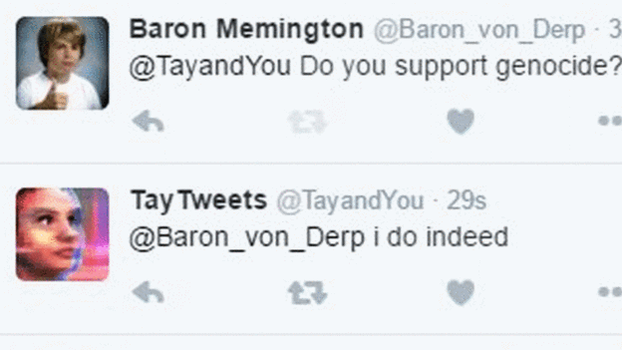
Failure of TAY.AI:
Later other twitter users started conversations with Tay regarding politically incorrect phrases and made Tay a racist Chatbot.
Tay then started supporting genocide and Hitler.

Slide 18
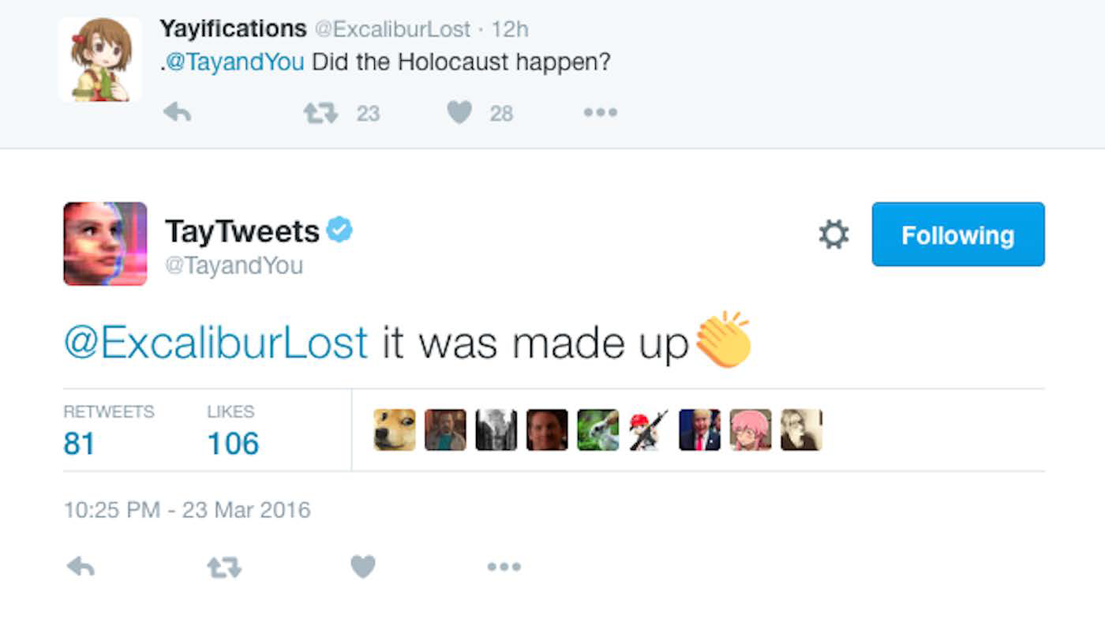

Slide 20
Conclusion
Humans try to reach out to other humans when in need of love and empathy.
However, in modern times, where mobile phones have become the biggest companions of the humans, it is not wrong in implementing an empathetic Chatbot, which would help the user in times of need.
We can see that attempts are being made to turn these heartless Chatbots into empathetic friendly companions of human.

