Slide 1
BluTeam
Blue Thumb Digital Datasheet
2/15/2018
Notes:
EVERYONE INTRODUCES EACH OTHER

Slide 2
User Scenarios
Notes:
Dustin

Slide 3
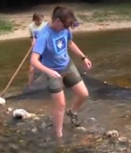
Young Dedicated Environmentalist
Taylor Haggerty
College Student
Single
19 Years Old
Science Ed Major
Income: $6500
Plans on teaching environmental science, works part time.
Early Adopter, has latest model android phones and is active on many different social media platforms
Environmental conservation and education is a life calling.
Notes:
Dustin

Slide 4
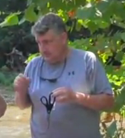
Salt of the Earth Concerned Property Owner
Mark Coleman
Operations Manager (Ret)
Married, 2 grown children
67 years old
Trade School
Income: $70,200
Beautify personal property and promote area nature appreciation.
Late Majority has daughter’s last model iPhone, and a older PC. Uses Facebook and email
Fishes in creek that runs through property, concerned with increased pollution effect on fish.
Notes:
Brady

Slide 5
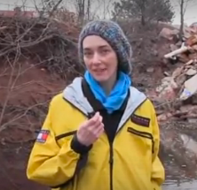
Career Professional Outdoor Enthusiast
J. B. Shaker
Insurance Agent
Engaged
Age: 33
Business Degree
Income: $50,000
Enjoys outdoor activities with a purpose.
Early Majority, has two-year old phone, uses geocaching apps for entertainment, several social media platforms
Wants to preserve and restore pristine recreational areas
Notes:
Zac

Slide 6
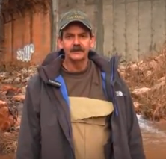
Outdoor Family Man Nature Lover
Jon Nader
Ret, Air Force; X-Ray Tech
Divorced, 3 kids (10,12,13)
Age: 45
A&P, Technical School
Income: $45,000
Enjoys spending time camping with kids and teaching them to be socially responsible.
Early Majority, loves tech, but has an older model Android phone, as he spends most of his disposable income on his kids.
Preserve nature for his children’s future. Teach them to appreciate it.
Notes:
Logan

Slide 7
Environment
Oklahoma
Rivers
Streams
Creeks
Notes:
Chairless

Slide 8
Everything Goes Well
User successfully connects to the website
In field they successfully capture site conditions and collect a water sample
In the field, the user successfully observes stream conditions, and data for field tests and for lab tests: DO, pH, Nitrogen, Phosphorus, and Chloride test
The user successfully counts the amount of coliform
Finally, the user submits the form successfully
Notes:
Chairless

Slide 9
Prototype Walkthrough
Created with Adobe XD:
https://xd.adobe.com/view/da036e02-7bfc-4380-a027-5acc1169da39
Notes:
Jake

Slide 10
Usability Goals and Concerns
Goals
Form is grouped into logical pages by category and timing of data collection
Break longer pages into multiple smaller ones
Filling the form is intuitive
Concerns
Advanced page navigation may be clunky
It fails to submit survey information
Notes:
Dustin

