Slide 1
Team 5 - Traffic Counters
Cognitive Walkthrough 2/15/2018
Caden Sumner
Noah de Longpré
Qu Shunhao
Connor Przybyla
Dustin Rens
Jamie Berger
Eamonn Daley
Ethan Manarin Richard Carpenter Joe Mayrose

Slide 2
Users / Environment
Users
MTU students enrolled in traffic engineering course
MTU professor of traffic engineering course
Environment
4-way intersections
Outdoors

Slide 3
Usage Scenario 1: Students Counting Traffic

Slide 4
Scenario
Robert Johnson, a Civil Engineering student has enrolled in CEE 4402 - Traffic Engineering. This student has been assigned a project that includes collecting data at a traffic intersection. His professor has required him to use a web application that allows users to record data regarding vehicle movements at specific intersections. After the student completes his data collections, the web application will convert the recorded information into a csv file that meets the specific specification of the professor.
Description

Slide 5
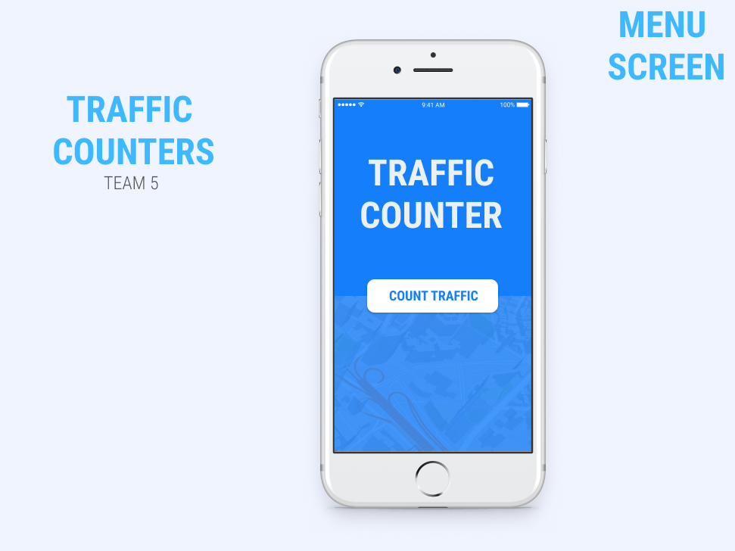

Slide 6
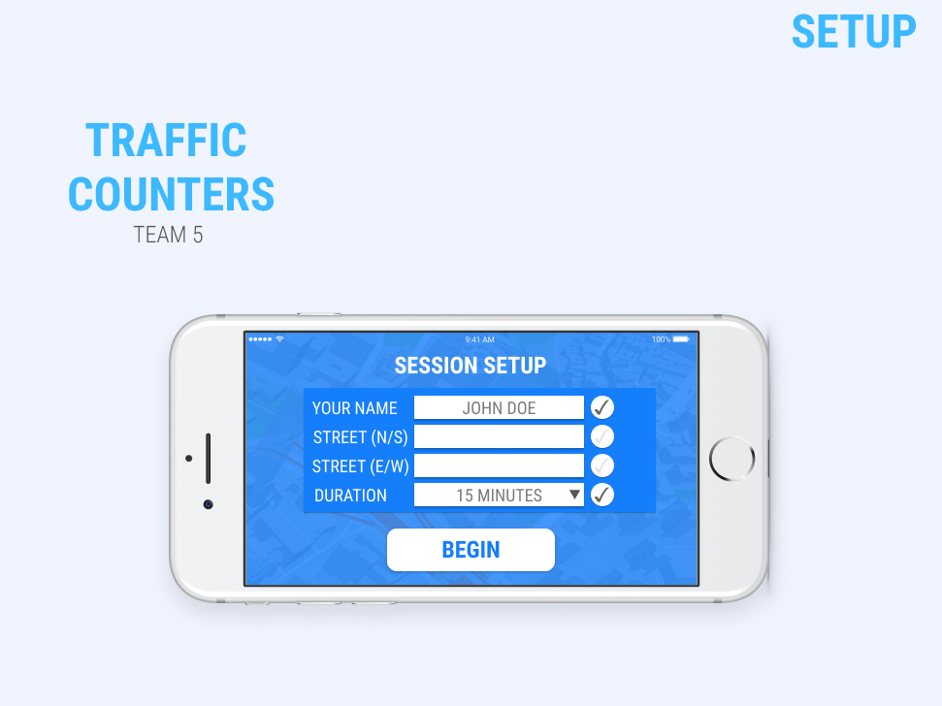
Considering intersection dropdown

Slide 7
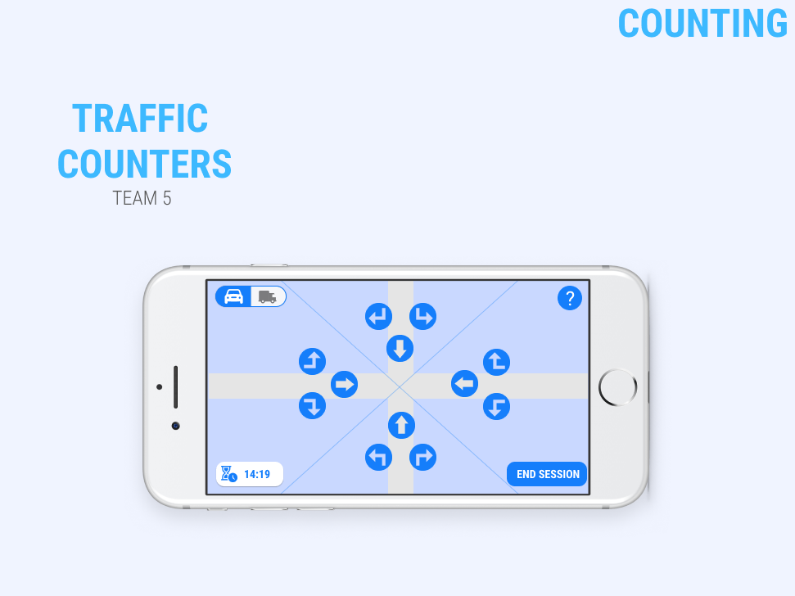

Slide 9
Usability Goals & Concerns
Goals
We want to make sure the app is easy to use and learn
Users can easily change mistakes and review input data
Concerns
Loss of connection / Loss of Data
Visibility during all hours of the day

Slide 10
Usage Scenario 2: Professor Pulling Data

Slide 11
Scenario
For a project in this course, the professor requires that the students go to a specific traffic intersection and collect data regarding the movements of vehicles that interact with the intersection. He provides the students with an interactive web application. This web application allows the students to record the traffic data and outputs this recorded information into a csv file for the professor to view and analyze.
Description

Slide 12
Usability Goals & Concerns
Goals
Easy for the professor to integrate into his current collection of data
Easy to obtain the csv files from students
Concerns
If sent through email, measurements could be lost

Slide 13
Simplified CSV File
An example of the data collected & sent to the client.
Student Name | Date | Time | Intersection ID | Time Interval (mins) | Car - Right | Car - Left | Car - Straight | Truck - Right | Truck - Left
Robert Johnson | 2/15/2018 | 14:30 | 3 | 15 | 7 | 5 | 10 | 2 | 1

Slide 14
Database Layouts
UserInfo -- Information of users
RecorderInfo -- Information of recorder
TimeInfo -- Information of recording time
Automobile -- Information of automobile
Record -- Collected Data

