Slide 1
Team Traffic
Aaron Lyons, Adam Reichanadter, Alex Smith, Anthony Chavez, Joe Kurtz,
Brandon Wichman, Joshua Peter, Sam Clement, Soheil Sepahyar, Yuchen Wang
4/2/2020

Slide 2
System
The Professor will create a game session and setup game settings, including a game code
Students will press the “Student” button and input the game code as well as a username and will be given a random origin and destination node on the map
Students will then take turns as directed by the professor
During the student’s turn they will be prompted to choose between two paths. After choosing a path they will press “End Turn” and the map will update based on their selection
The game session will end after a predetermined number of iterations or at the professor’s discretion

Slide 3
Users
Professor (Dr. Kuilin Zhang)
Will use web-app as teaching aid for traffic route optimization
In charge of creating, setting up, and monitoring game session
Students
Main users of the web-app
Will participate in choosing routes to and from vertices on the network graph

Slide 4
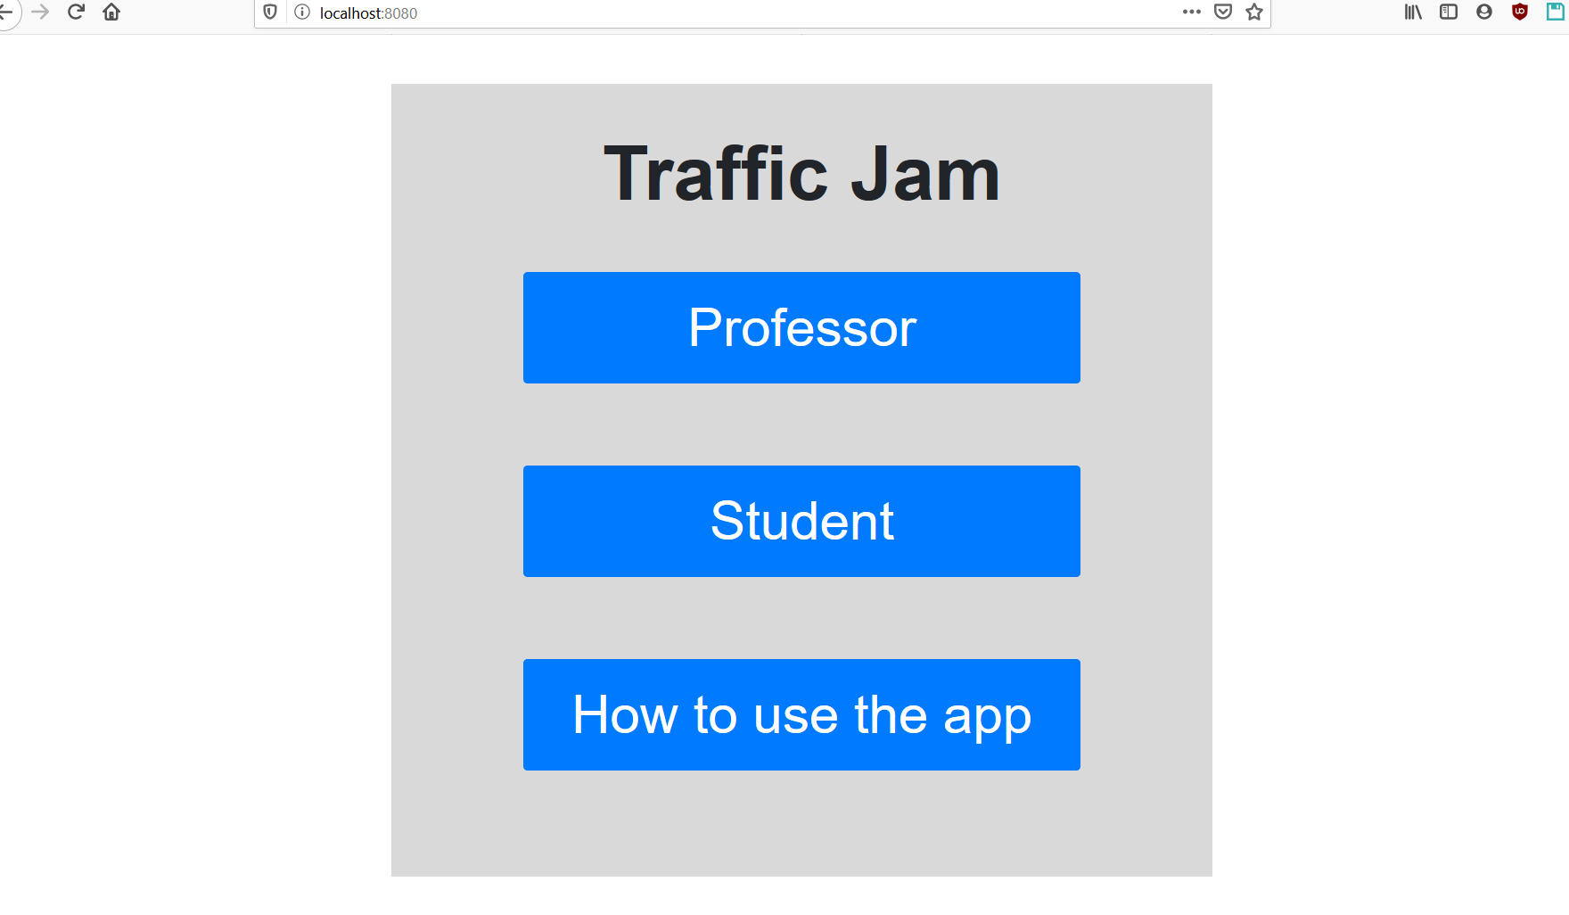

Slide 5
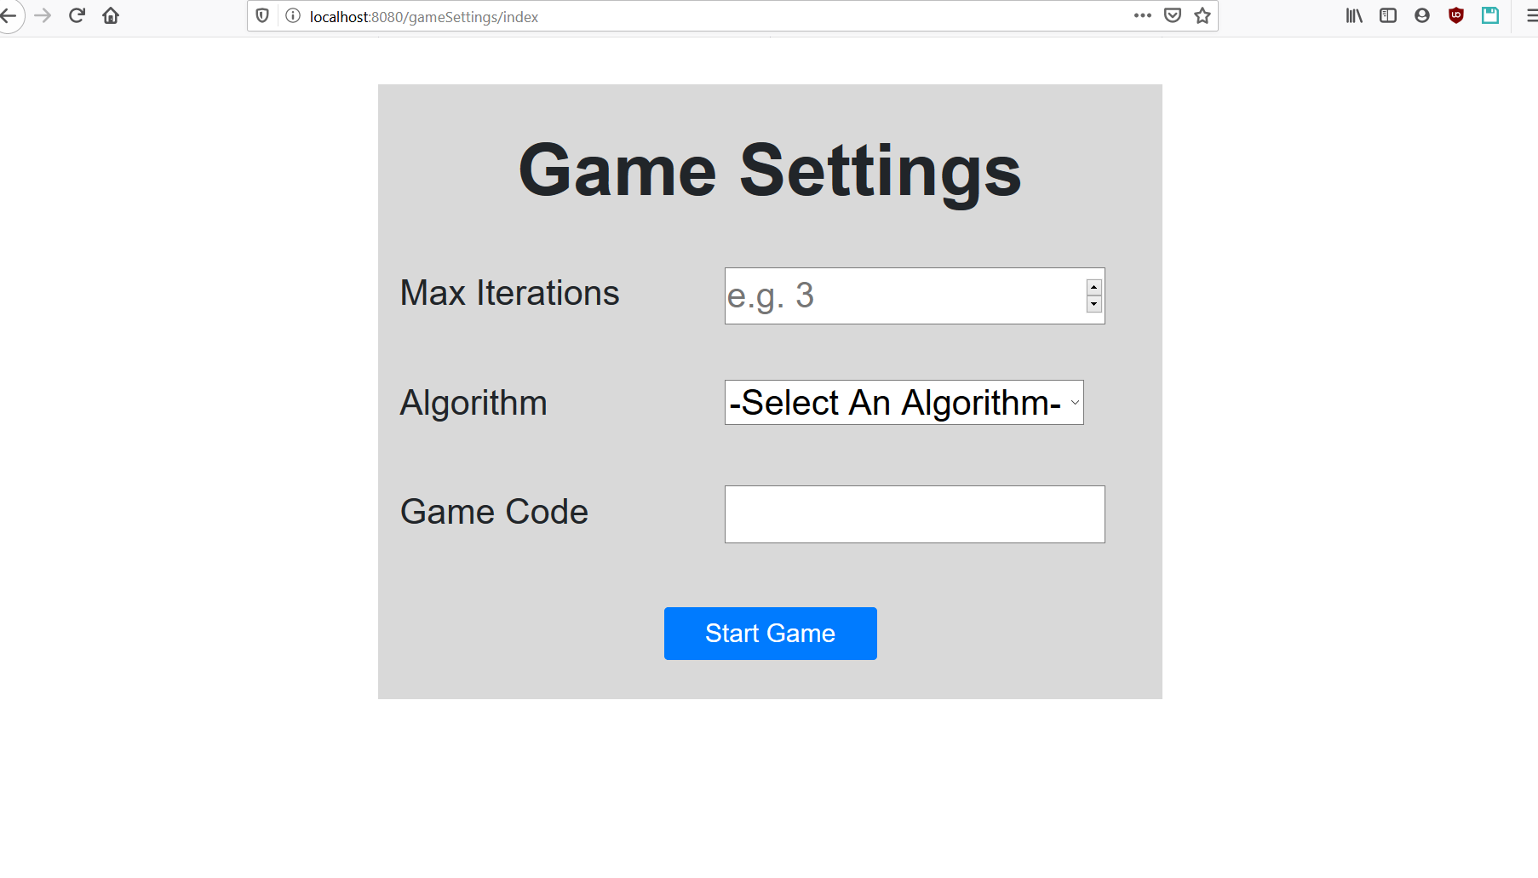

Slide 6
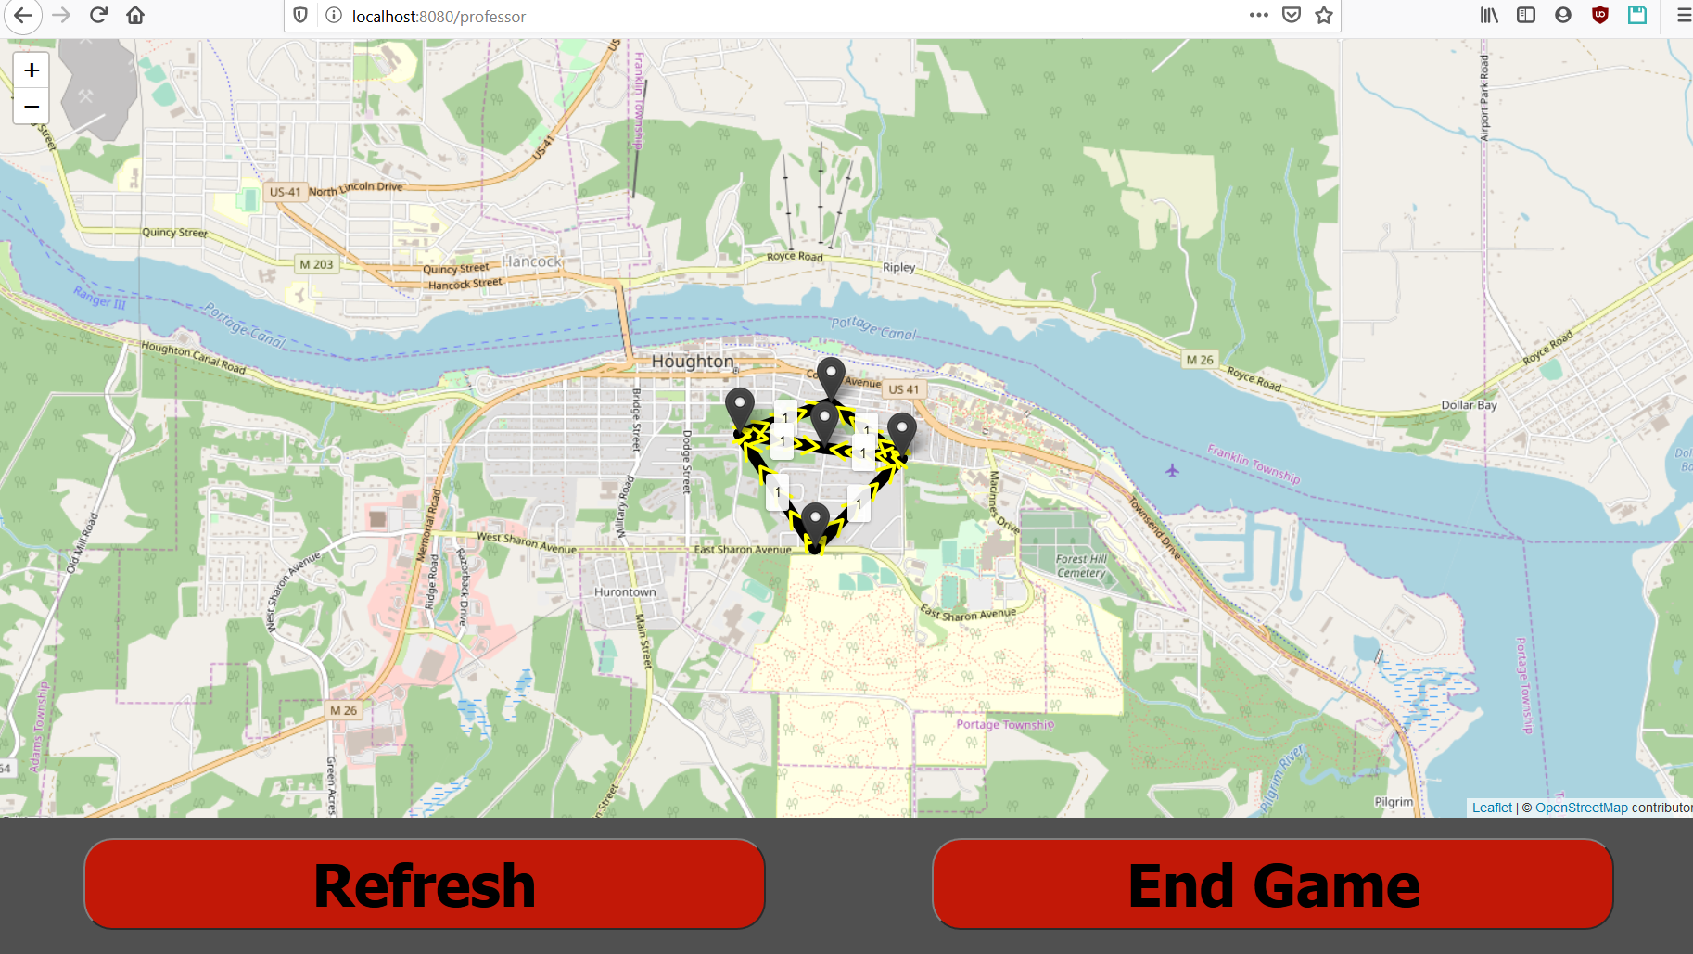

Slide 7
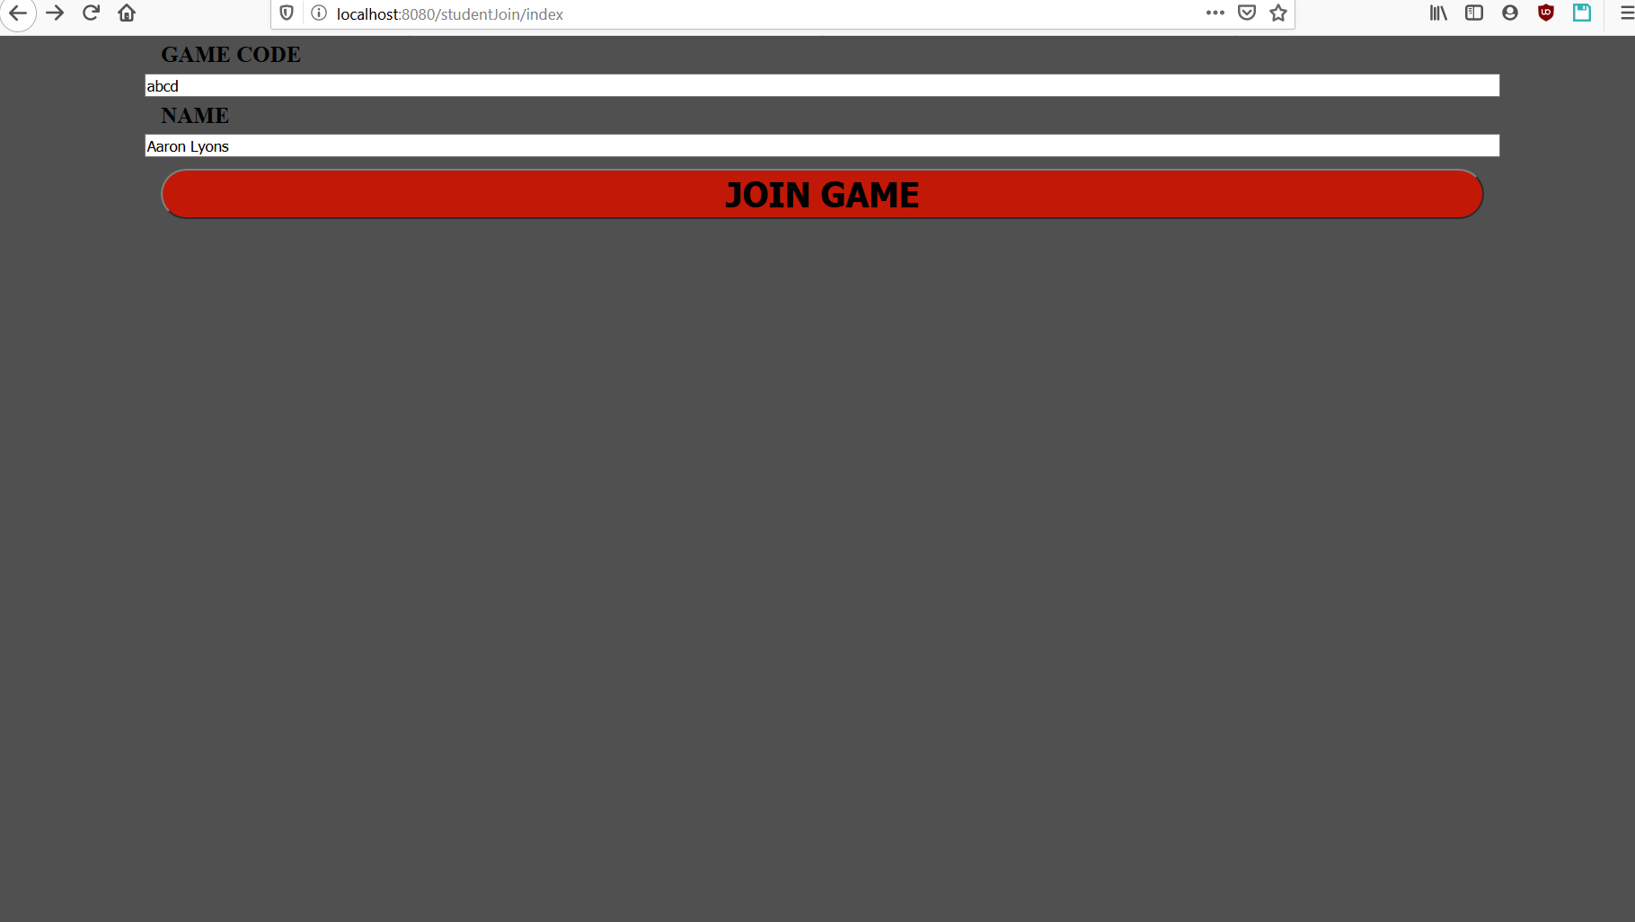

Slide 8
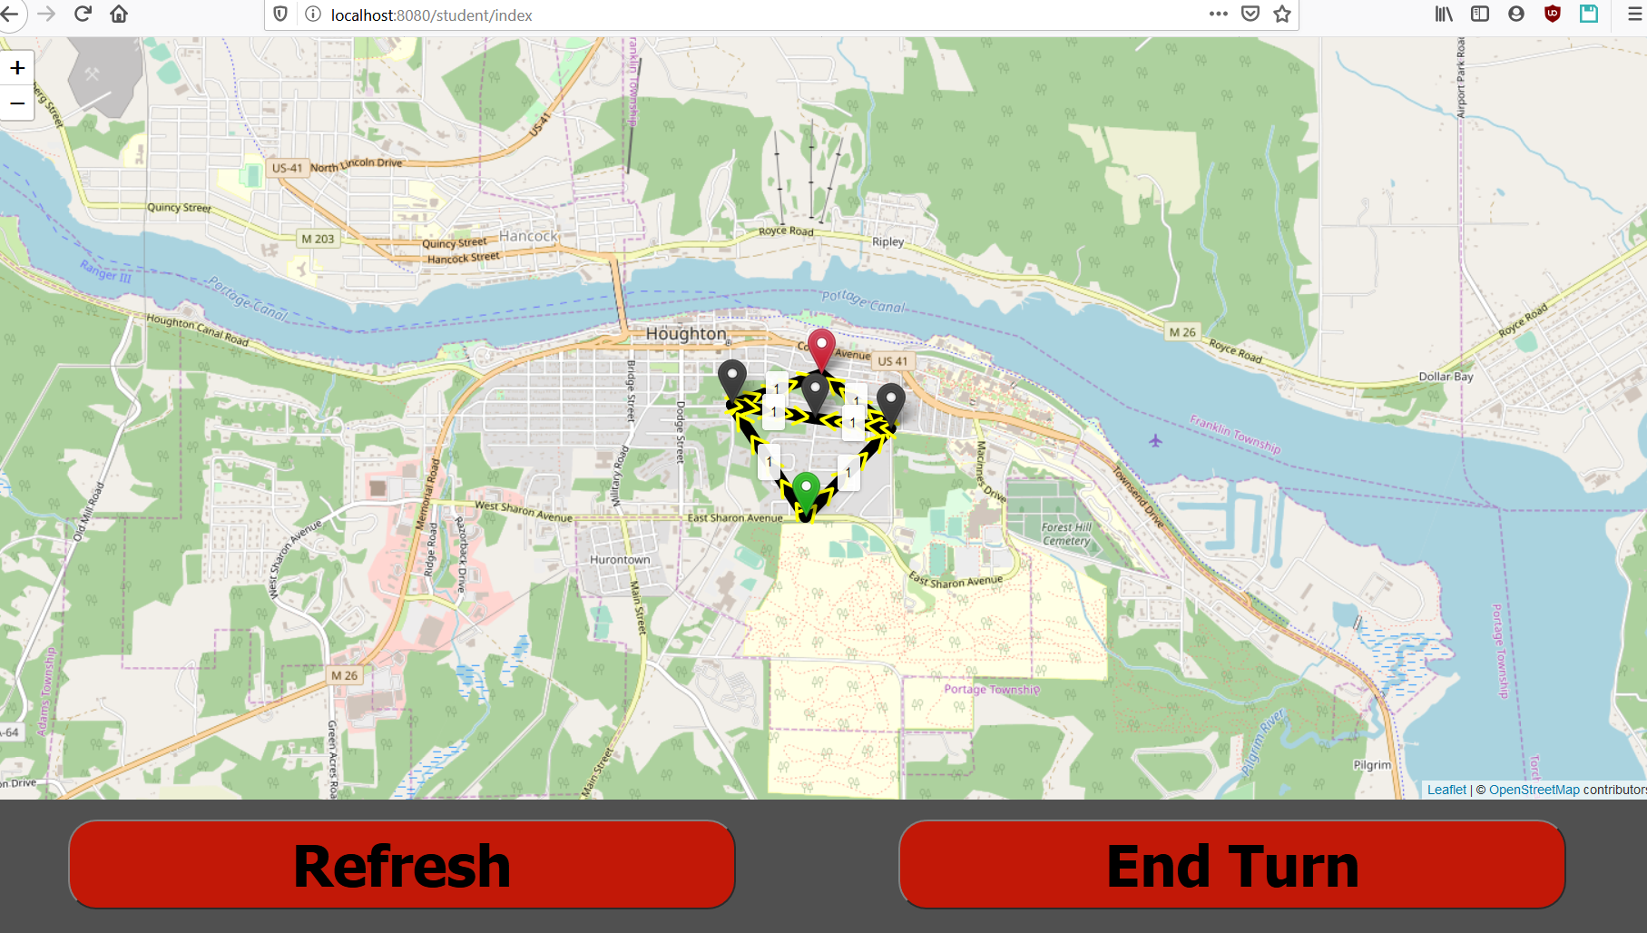

Slide 9
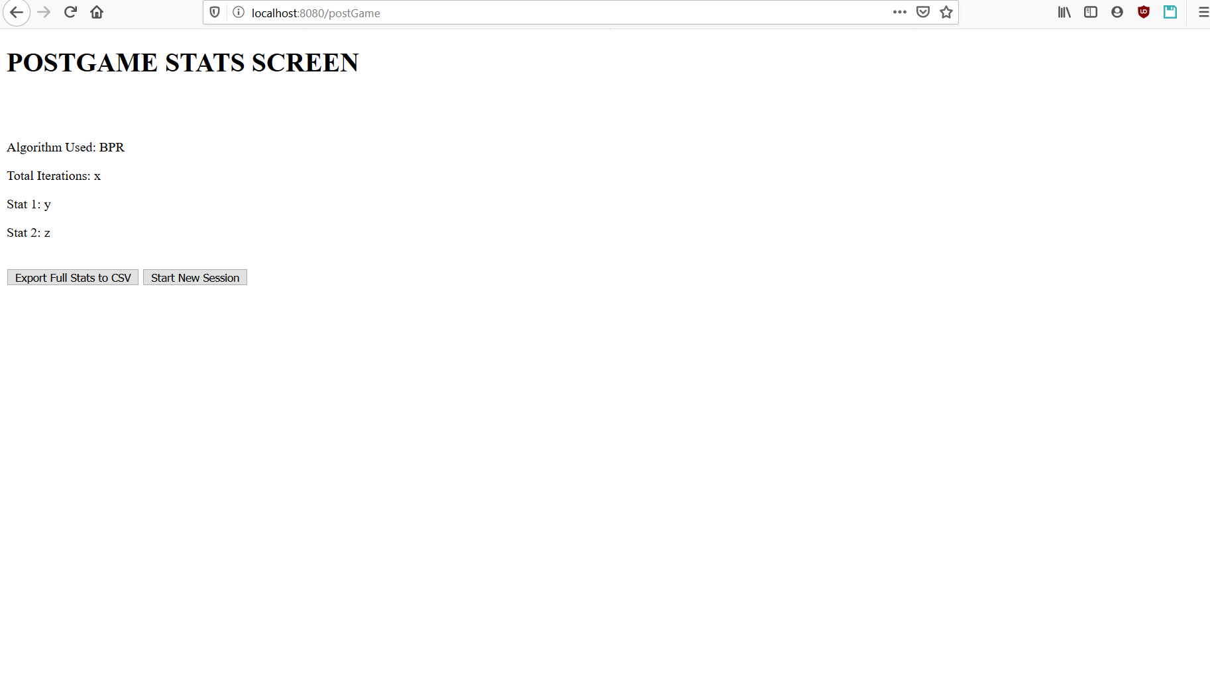

Slide 10
Instructional Content
Student Instructions
Navigate to the website and enter your name
Wait for the instructor to start the game
Press the “Student” button and enter the game code and your name then press “Join Game”
Wait for your turn to choose a route, do not take your turn until you are told by your professor
When it is your turn, choose one of the two presented paths
Once path is set, choose “End Turn”, and notify instructor
Professor Instructions
Login with master credentials
Set up game session and choose a game code, make sure you tell your students the code
Start the “game” session, and tell one student at a time to input their origin and destination points
Monitor the network
6) When the game is finished, choose the “End Game” to see and download the end of game stats

Slide 11
Potential Usability Concerns
Does the content scale well to mobile phones?
Is participating in the game less intuitive or more difficult on a mobile phone?
Is the interface intuitive for first time users?
If students take their turns out of order they can take another students turn so they have to pay attention to the professor to know when it’s their turn

Slide 12
What’s Complete/Future Work
Future Work
Turn ordering
Professor login page
Dijkstra’s algorithm implementation
Post game stats screen
CSV download
Unify styling
“How to Use” button on home page
Complete
Game Settings page
Professor view
Home page
Game creation
Students can join a game
Students can choose a path
Students and Professor can see congestion

Slide 13
Any Questions?

