Slide 1
Micro:bit USB Grapher
Team Micro:bit
2/11/2020

Slide 2
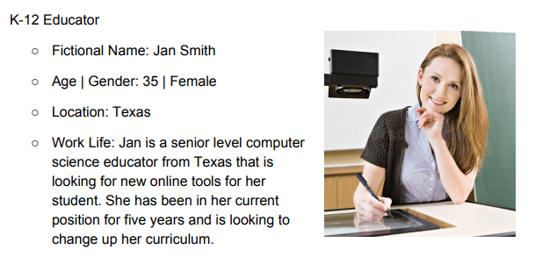
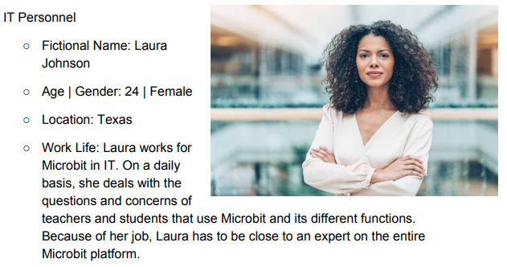
Cognitive Walkthrough

Slide 3
Cognitive Walkthrough - Nominal Users and Environment
Middle/High School Classroom
Teachers will be developing lesson plans to teach students about graphing, data collection, and data analysis.
Students will be using the device/app to log data and visualize it in a graph format.
The student starts at the home view
They begin logging temperature data by pressing start with the Micro:Bit set to collect temperatures.
The data is collected and stored in the browser in increments specified by the student.
A graph displays the data gathered and provides some statistical information.
The student then downloads the results to submit to their teacher.

Slide 4
Error Handling Scenarios (IT Testing)
Long Duration Data Collection
An IT professional wants to collect temperature data over the course of a couple days/weeks.
They connect the Micro:Bit and begin data collection.
The app should then run collecting data until the user requests that it stop doing so.
The user then downloads the data as a csv file to their machine.
IT begins collecting data with the device.
The data is graphed and collected.
The internet fails momentarily during collection.
The app preserves existing data and switches to offline mode.
User may download the data.
When internet returns the user can import the saved data and continue

Slide 5
Cognitive Walkthrough - Nominal Use Scenario Description
Data Collection
A user wants to collect data over a period of time so that they can notice interesting phenomena occur.
They connect the Micro:Bit and begin data collection.
They can view the real time data being displayed on the application dashboard.
If an interesting event occurs, the user can zoom, pan, or view the values of the data collected.
The user connects their microbit
They begin collecting data by pressing start.
Data streams and graphs in real time from sensors
Stops recording when “stop” button is pressed.
User can manipulate the display and analyze the data.

Slide 6
Additional Users and Environments
Classroom Lesson
Teacher provides a lesson with their students about data collection and analysis.
She introduces Micro:Bit and have the students walk through steps of logging and viewing positional data with the app.
The data then can be viewed and manipulated on the site.
Open Source
Bill mentioned that people outside of K - 12 Education may be interested in contributing and using our application.
We will need to include documentation on how to contribute and understand the project.

Slide 7
Usability Goals and Concerns
Goal: Straightforward/Intuitive UI (Learnable, Effective)
The interface should be simple and easy to understand with minimal explanation needed to navigate and use the application effectively.
Goal: Present information in a clear and understandable way (Informative)
The interface should make data easy to parse, analyze, and evaluate. The display should be clean and focused on the data
Concern: Utility
What sort of applications beyond just numeric data will the interface support? In other words, what sort of experiments/data recordings might not behave well in our framework
Concern: Aesthetics
The interface has the potential to be cluttered/confusing with multiple graphs/datasets, and bland with fewer. How can we present data in a visually appealing but efficient way

Slide 8
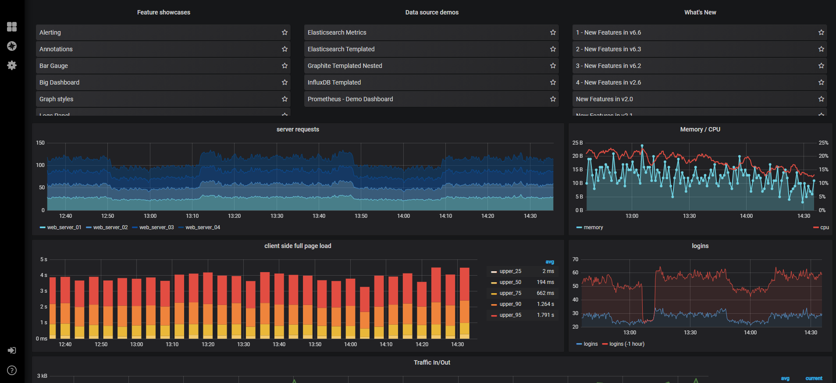
Prototype

Slide 9
Prototype - UI Layout

Slide 10
Prototype - Continued
Graphing dashboard similar to the previous slide
Focus on features:
Zooming
Panning
View points-of-interest
Less busy than previous graphing dashboard
Live Demo!
https://microbit-grapher-proto.herokuapp.com/

Slide 11
Instructional Content Plan
Combining the question that have risen, we can create Heuristics that can cover the wide array of topics within our app through:
Interface Quality
New Barriers to Entry
Easy-Access Help Documents
Customizable Recording Properties
Few Errors
Because the app is rather easy to use and follows conventions that are commonly found in other apps, the team now has a very clear path forward as the instructional content does not need to be overly complicated.

Slide 12
Instructional Content Plan - Continued
As stated in the Heuristic evaluation, as we move forward, it will be important for the Instructional Content to show all different variables that will be a part of the app design.
We also have to make sure that the design documents accurately show the user which functions they can use, which should be elaborated on before the instructions commence.

