Slide 1
Soil Infiltration Usability Test Report
Usability expert : Pooja mothukuri

Slide 2
OUTLINE
Brief Introduction – Soil Infiltration App
Test procedure and setup
Pre-Test Questionnaire Result
Scenario1
Scenario2
scenario3
Post-Test Questionnaire Result
Bug Report
Summary

Slide 3
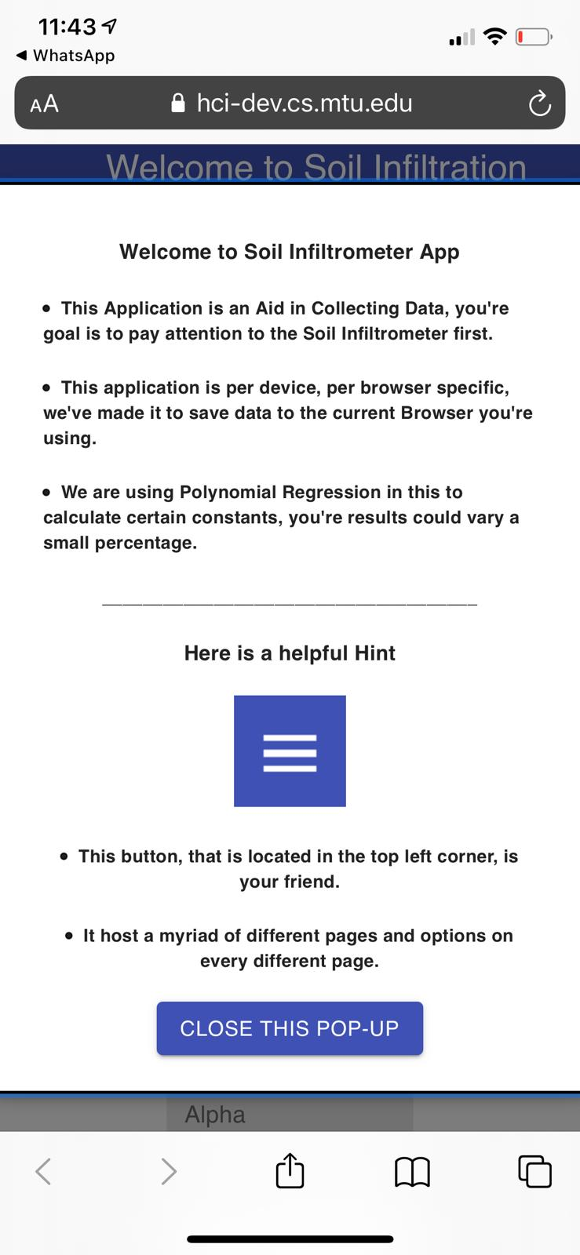
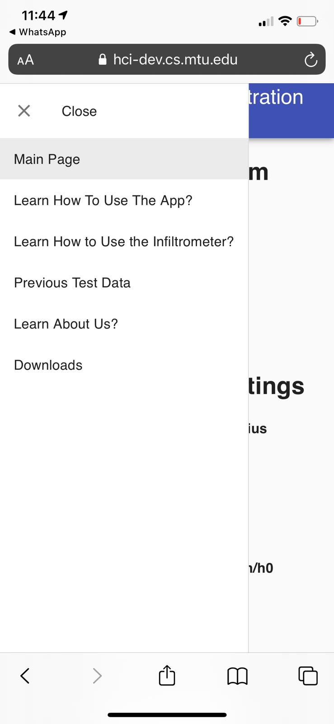
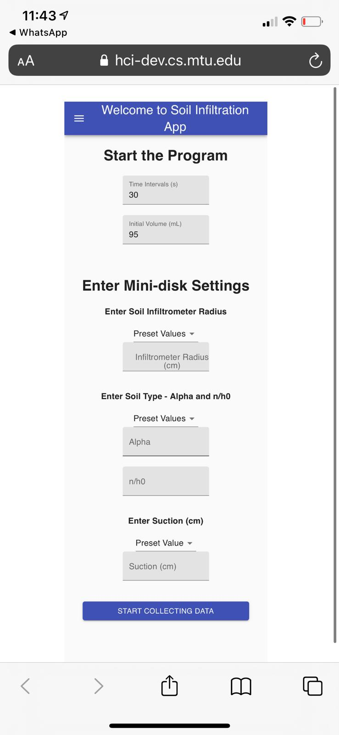
Soil infiltration

Slide 4
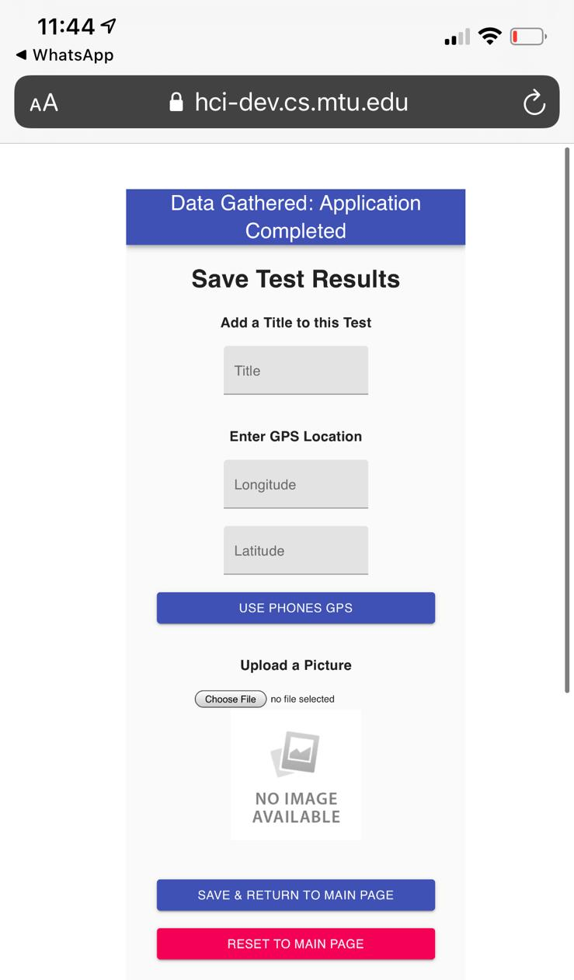
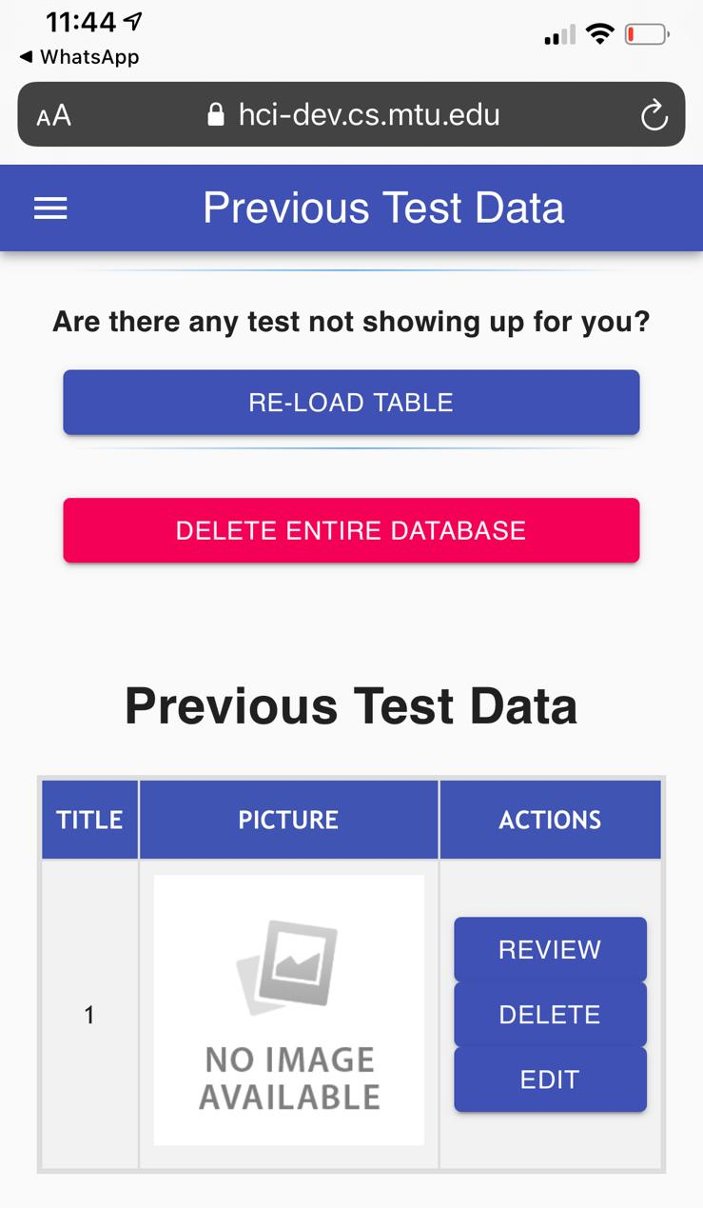

Slide 5
TEST PROCESURES AND SETUP
SETUP:
Zoom testing
Meeting link was emailed to the testers and participants 2 days prior to the test.
Screen recording
Procedure:
1. Greetings and introduction.
2. Google form Consent from the participant
3. Explain the purpose of the app
4. Pre-Test Questionnaire in google form
3. Read the testing scenario to participants
5. Share the link of Soil Infiltration app
6. Conduct the testing, share screen before starting tasks
7. Performed the post-scenario interview
8. Post-Test Questionnaire in google form

Slide 6
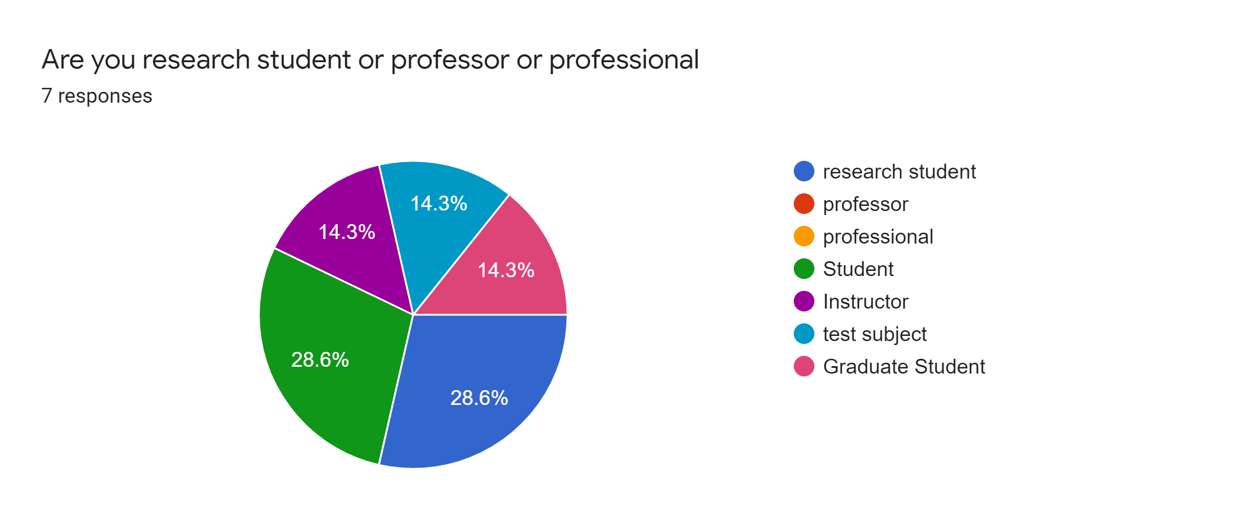
Pre-Test Questionnaire Result
Attendance: (100%)
All participants are present for the usability testing.
AGE & ROLE–> 18-25

Slide 7
Pre-Test Questionnaire Result

Slide 8
Pre-Test Questionnaire Result

Slide 9
Scenario1 : Non Student (road engineer )
Goal :
To determine if the participant can use the app easily or is it difficult or confusing to navigate
Task list :
Open application and read pop up
Learn about app
Learn how to use the app

Slide 10
Scenario1 : Non Student (road engineer )
Test result :
Time taken to navigate: <3sec
No questions asked by participants during first scenario.
They are comfortable while doing their tasks.
Overall feedback given by the participant - satisfied

Slide 11
Scenario2 – Research student
Goal:
To determine if participant is able to enter data and save it
Task list :
Read pop up and enter given data in the input fields
Checked for the entered data in the table
Save and return to main page

Slide 12
Scenario2 – Research student
Test result :
Time taken to navigate: <3sec
Participants took some time at the preset values, but they figure it out
They seem confused while doing their tasks.
- After entering volumetric data
Overall feedback given by the participant - satisfied

Slide 13
Scenario3 - Research student
Goal:
To determine if user is able to edit and review from previous test data
Task list :
In previous test data edit title, location and picture
After editing save and return to main page
Review the edited data

Slide 14
Scenario3 - Research student
Test result :
Time taken to navigate: <3sec
Participants looked around the page and they figure it out in no time.
They seem confused while doing their tasks.
- Especially to save their changes and return to the main page
Overall feedback given by the participant - satisfied

Slide 15
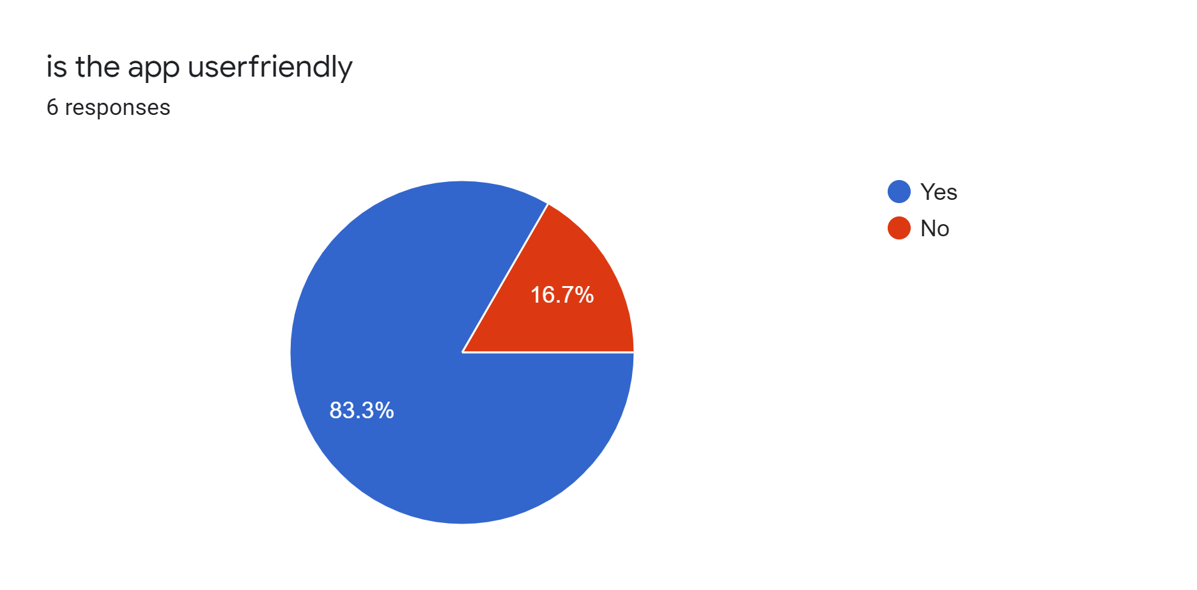
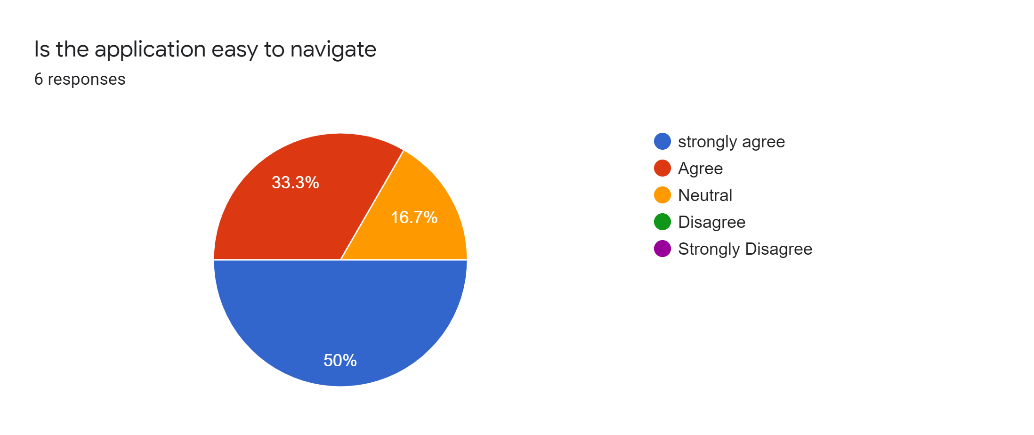
Post-Test Questionnaire Result

Slide 16
Post-Test Questionnaire Result

Slide 17
Feedback
They don't know what soil infiltration is, but the more time they spent using the application the purpose and functions of it became more clear
Lots of words in the pop up, not a lot of words in the guide.
Good overall, the 0 bug was kind of annoying and would like to see a save button added to the edit screen
This app is clean and is easy to use and understand, even for someone who has had no experience with soil infiltration
The app is simple and effective in its purpose.

Slide 18
Bug Report 1
Sustained zero on field reset: Severe
When the user is entering the current volume level in volumetric data field, after they enter it the field resets to the value 0. this bug has to be taken care before application goes on otherwise the user will enter weird values like 040 050 015. So, when the input field is reset it should reset to null instead of 0

Slide 19
Bug Report 2
Need save button on Edit test screen: Severe
The user is confused when trying to save the test and was looking for a save button on the page rather than looking in the menu.

Slide 20
Bug Report 3
GPS request on iPhone (may have been user error): Minor
A participants iPhone was unable to fill GPS data using phone’s location, there was no request to access location when attempting to provide the location data.
Note : the person has to click allow in order to share location, if by mistake any one didn’t allow location sharing they can not provide again.

Slide 21
Recommended changes
Even without giving any input, it prompts to next page. Need validation
Save button be need to in the same page after editing the title and location
Fixing reset to zero in the volumetric data entry field
Moving preset values above the manual entry field
Even after volume is given 0, the pop up to enter volume shows up
Give another pop up or note near location about the “allow” and “don’t allow”

Slide 22
summary
Ios and android phones are used to test this application, as it is mainly designed for mobile application. All the functionalities were working good and there is just minor bugs/errors to be taken into consideration. Overall all the participants are happy to test the application, also they felt application is user friend and easy to navigate.
More details will be posted in the website
http://www.csl.mtu.edu/classes/cs4760/www/projects/s21/grad8/www/

Slide 23
Next Presenter
Grad Student: Isaac Appleby

