Slide 1
Water Matters
The Creative Types 2/9/2021

Slide 2
User Personas
Persona-1:
Gabriella D’souza
Colonia resident in Arizona
64 years old
20 year resident
Spanish speaking
Experience water shortages
Wants to learn about water conservation
Lives alone
Has a smartphone
Uses it mainly for phone calls
Persona-2:
Gustavo Fransisco
Colonia resident in Texas
51 years old
12 year resident
Bilingual
English
Spanish
Experiences Water Shortages
Wants to learn about rainwater harvesting
Lives with 5 family members
Has smartphone

Slide 3
Cognitive Walkthrough Use Scenario 1
Learn about water conservation

Slide 4
Scenario 1 Description
Persona: Gabriella
Open Water Matters App
Selects Spanish Language Version
On Homepage
Select water conservation page from toolbar
Reads page and studies images
Notes:
Gabriella is a resident of a colonia, so she wants to learn more about water conservation. She opens the Water Matters app and selects her desired language of spanish, which brings her to the spanish version of the homepage.
She then navigates to the water conservation section of the app by using a toolbar on the top of the page. This page has a lot of reading material about how to effectively conserve water. On this page, she reads all the information that the app has to offer her.

Slide 5
Paper Prototype

Slide 6
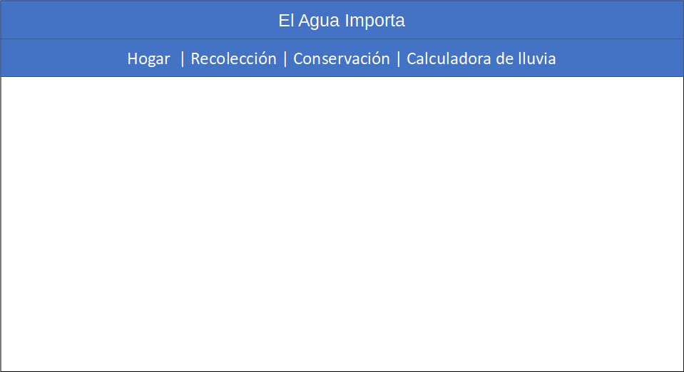
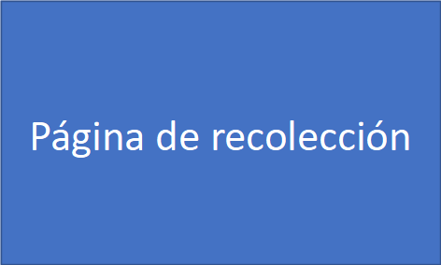
Paper Prototype

Slide 7
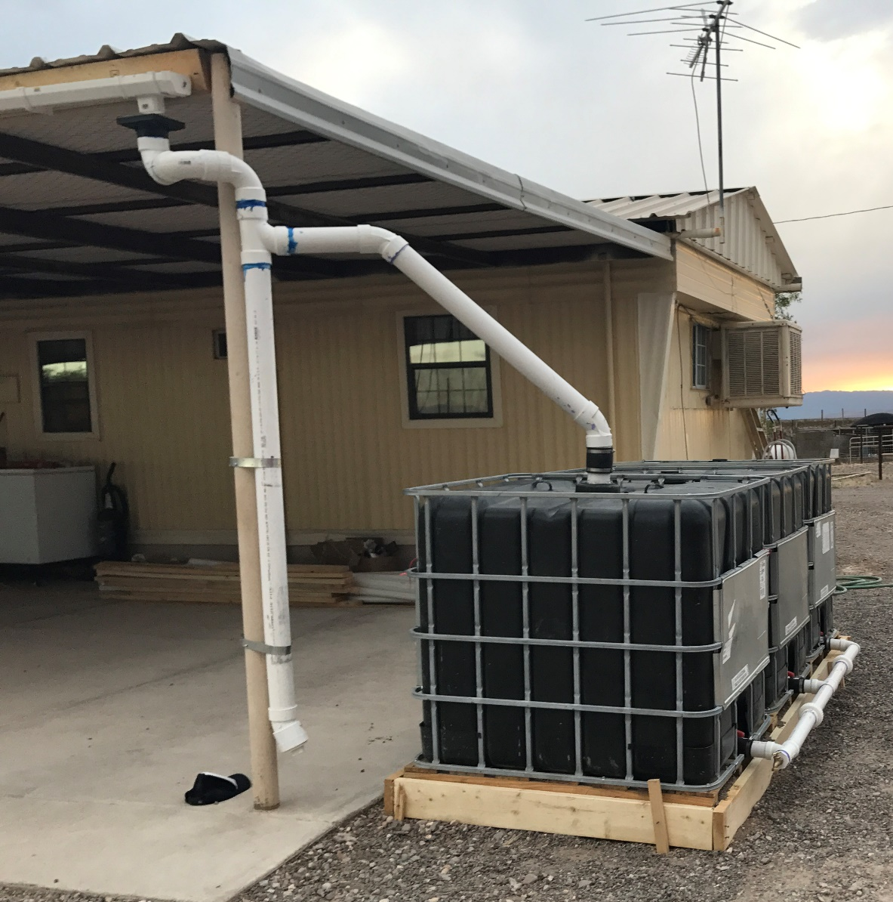
Paper Prototype
Example article text
Graphic title

Slide 8
Cognitive Walkthrough Use Scenario 2
Rainwater collection video and calculator Error

Slide 9
Scenario 2 Description
Persona: Gustavo
Opens water matters app
Selects English Language Version
On Homepage
Navigates to rainwater collection page from toolbar
Reads through information and watches videos
Has to scroll through the webpage
Navigates to rainfall calculator page via button on bottom of page
Enters both numeric and string data into the calculator and presses calculate button
Error Message appears
Reetners all numeric data and presses calculate button
Notes:
Gustavo lives in a colonia that does not have easy access to clean drinking water, so he wants to learn about how to use his home to collect rainwater.
To do this he opens the water matters app on his phone and selects his desired language of english, which brings him to an english version of the homepage.
He navigates to the rainwater harvesting page of the app by using a toolbar on the top of the page. After scrolling through the information on the page, he sees a link to a rainfall calculator on which he clicks.
There he has to enter numeric data into the calculator about the dimensions of his roof, but instead he enters a string into the text box. He then clicks the calculate button. The app has a pop up saying the information he entered is invalid, and should type a integer into the text box

Slide 10
Paper Prototype

Slide 11
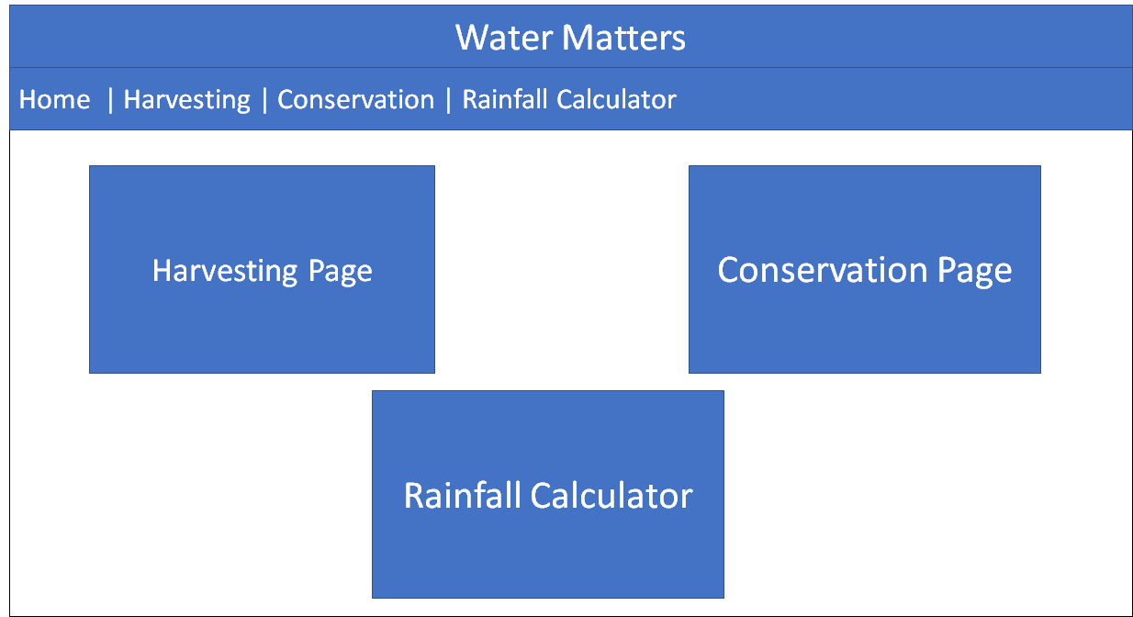
Paper Prototype

Slide 12
Paper Prototype

Slide 13
Paper Prototype

Slide 14
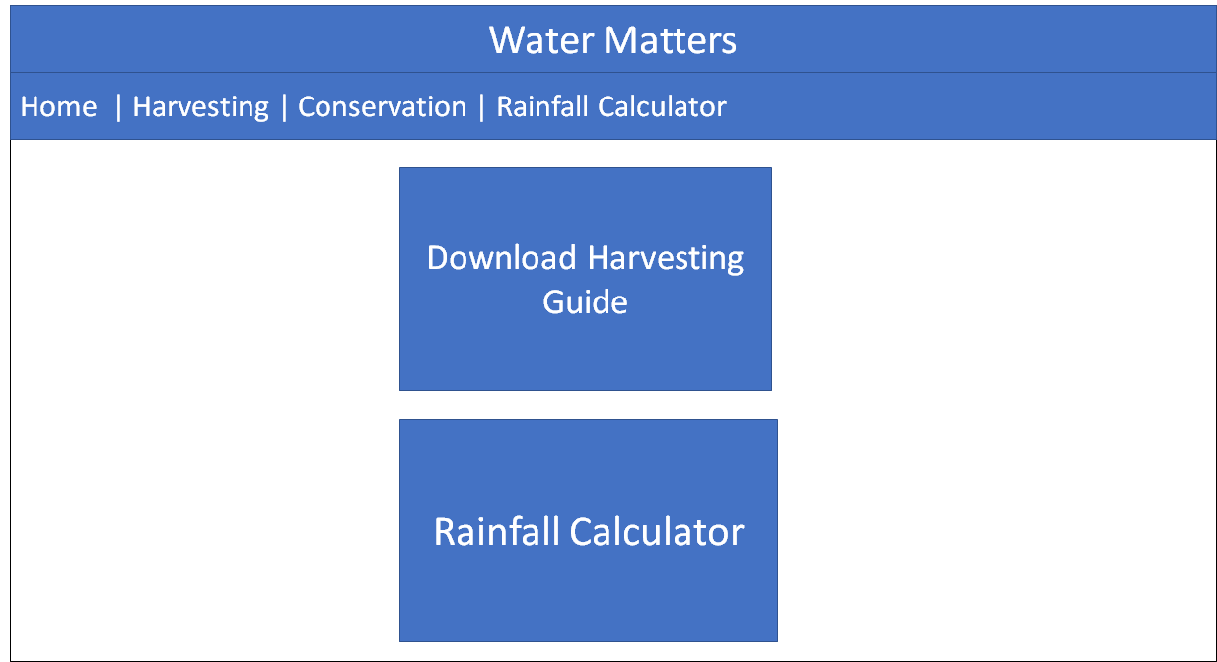
Paper Prototype

Slide 15
Paper Prototype

Slide 16
Paper Prototype

Slide 17
Paper Prototype

Slide 18
Paper Prototype

Slide 19
Goals Concerns
Usability
Easy Navigation
Easy to look at
Engaging
Language Selection
Information Dump
Outdated Technology

