Slide 1
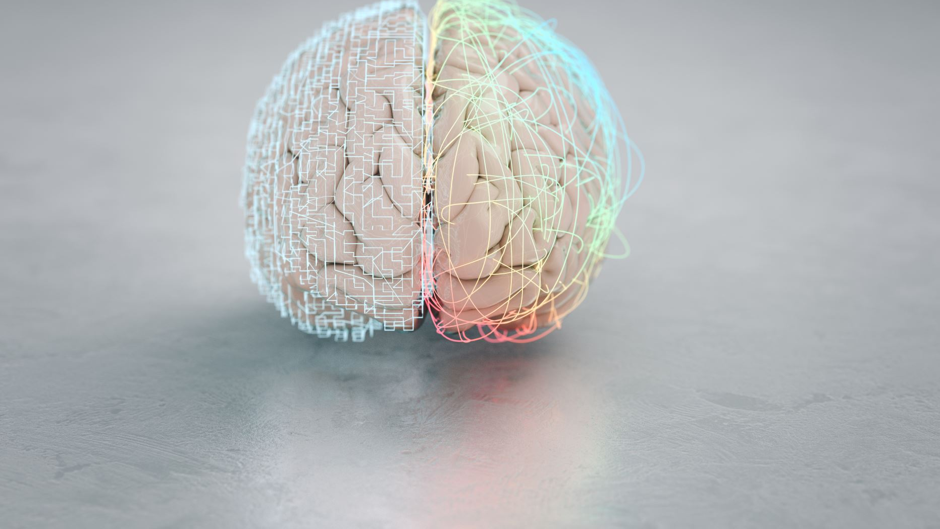
Presenter : Aakash Gunda Mentor : Dr. Robert Pastel Course : CS5760
Topic : Human – Computer Interaction in Brian Computer interfaces Via Virtual Environments

Slide 2
Agenda
Abstract
Introduction
System Requirements and user controls
Improvements of HCI Via BCI
Integration of Virtual environments
Controversial Issues
User Mental State
Key takeways : SRBF
Conclusion

Slide 3
Abstract
Brain-Computer Interfaces aim to establish communication between the human brain and Computers,yet face efficiency and reliability challenges.
Recent research suggests that leveraging Virtual Environments could enhance Human-Computer Interaction in BCI systems.
This paper explores how VEs' characteristics can enhance HCI, potentially addressing BCI drawbacks, with a focus on recent advances and future trends in the field.

Slide 4
INTRODUCTION
Brain-Computer Interfaces (BCI) are systems that attempt to establish communication between the human brain and a computer , Inorder to replace the natural connection between central nervous system (CNS) and musculoskeletal system.
This paper concentrates more on the following aspects
Main characterstics of Virtual environments
How VE’s improve HCI
Extensive revision of recent advances in field
How improvements VIA
VE Help HCI to overcome drawbacks of BCI

Slide 5
Virtual Environments: System Requirements and User Concerns
Human perceptual abilities pose challenges to creating VEs that convincingly deceive human perception.
VEs require components such as 3D generation, Human-Computer Interaction (HCI), and sensory output interfaces including auditory, visual, and haptic devices.
Various interaction techniques are employed in VEs, including graphical interfaces, speech recognition, and tracking systems, to enhance immersive experiences.
Users are concerned with achieving cognitive equivalence between virtual and real worlds, emphasizing factors like presence, immersion, user characteristics, and involvement.
Immersion in VEs depends on the quality of sensory presentation and the level of interaction provided.

Slide 6
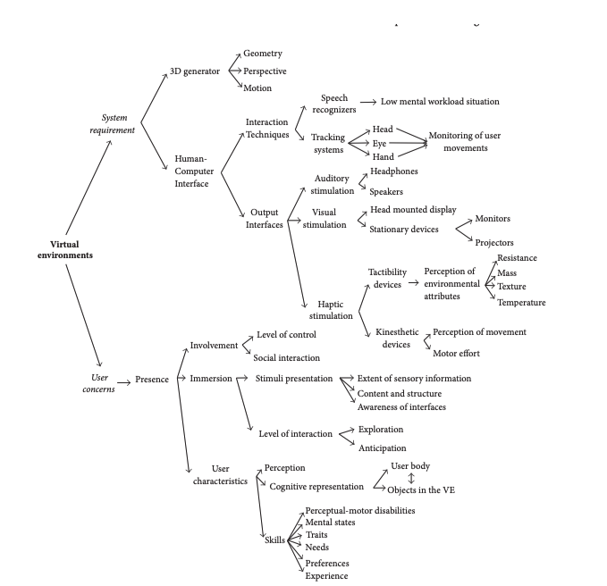
Sturcuture of VE based on systems and user concerns

Slide 7
Improvements of HCI via Virtual environments
3D representations in VE enhances the user experience compared to 2D.
It stimulated the cognitive process , vital for HCI.
Processes include Active engagement of spatial memory, attention, and perception.
Potential for modulation aligning with research goals.
VEs excel in fostering user engagement and positive UX, However, VEs alone cannot optimize HCI
As user interaction within them may become inefficient without consideration of human factors and user characteristics alongside realistic and sophisticated design principles.

Slide 8
Integration of Virtual Environments and Brain-Computer Interfaces
VE’s are widely used in BCI development to boost motivation and immersion in various scenarios, from daily life to gaming.
BCI applications in VEs include controlling virtual cars, navigating VE , operating domotic systems.
Invasive and noninvasive methods are used for signal acquisition in BCI systems, with EEG being preferred for its accessibility and non-invasiveness.
BCI functions involve calibration, training the machine to recognize user brain patterns, and control, enabling device manipulation based on brain state modulation.
BCI systems are categorized as active, reactive, or passive, depending on whether they rely on user commands.

Slide 9
Controversial Issues
Neglect of User Needs: Inadequate attention to end-user requirements contributes to BCI illiteracy among healthy users.
User Experience Dependency: User behavior and experience in BCIs depend heavily on training procedures, feedback methods, and motivation.
Real-World Challenges: BCIs face difficulties in real-world environments due to noise and dynamics, requiring robust signal processing algorithms.
Lack of Clear Assessment Metrics: Current BCI assessment lacks clear metrics for user comfort and task concentration, focusing primarily on machine factors like accuracy.

Slide 10
BCI Implementation under More Realistic Situations
Limitations of Laboratory Settings: Laboratory settings restrict human interaction, but virtual simulations offer more direct interaction, facilitating learning under realistic conditions for BCI implementation.
Study of Human Factors and Distractions: VE’s enable the concurrent study of human factors and distractions, which can impact BCI usability.
Importance of Realistic Situations: Realistic situations in virtual environments significantly affect BCI system performance, extending beyond technological sophistication to encompass user relevance.
Enhancement through Contextualized Environments: Explicit representation of tasks in virtual environments enhances Motor Imagery (MI) generation, leading to higher system accuracy compared to traditional methods.
Leveraging Previous Knowledge: Contextualized virtual environments leverage users' previous knowledge, improving EEG signal modulation through MI activity.
Significance of Environmental Conditions: Providing appropriate environmental conditions in virtual environments is crucial for enhancing BCI performance.

Slide 11
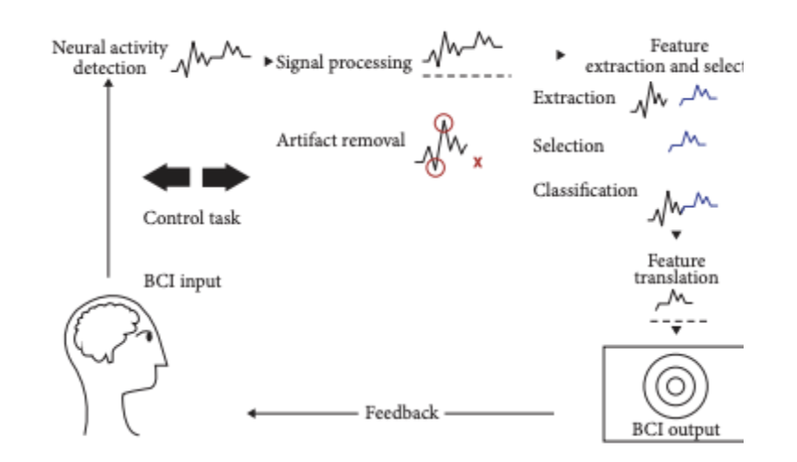
User mental State
User mental state is crucial for stable performance in BCI systems, particularly in modulating EEG signals through Motor Imagery activity.
A study used VR technology to enhance mindfulness and meditation, tracking hand movements and EEG activity to improve MI training.
Another study introduced a virtual environment where users controlled an avatar based on concentration levels, using ERP-based BCIs.
This improved user-system interaction, emphasizing concentration's role in BCI performance.

Slide 12
S
Systems: BCI Systems aim to establish connection between human brain and computers
They hold immense potential for various application such as neurorehabilitation, robotics & smarthomes. Despite orginating in 1960, BCI Technology still faces challenges in efficiency.

Slide 13
R
Role of Virtual environments Virtual environments (VEs) offer distinct features that can address HCI challenges in BCI systems.
VEs provide immersive and interactive platforms, enhancing user engagement and control.

Slide 14
B
Benefits of VE in HCI for BCI
Improved User Experience: VEs can create more natural and intuitive interfaces, reducing cognitive load and user frustration.
Enhanced Training and Learning: VEs enable more effective training protocols, accelerating user proficiency with BCI systems.

Slide 15
F
Future Outlook
Integrating virtual environments into BCI research and development could lead to breakthroughs in usability and effectiveness.
Continued interdisciplinary collaboration and technological advancements will be crucial in overcoming remaining challenges and realizing the full potential of BCI technology.

Slide 16
Conclusion
Initial VE Applications in BCI Research:
Focus on user motivation, attention maintenance, and feedback mechanisms.
Early perception: VEs primarily as tools for rendering realism.
Transition to Tridimensional Representations:
Shift towards 3D representations for enhanced HCI.
Stimulates cognitive processes during navigation and exploration.
Cognitive Processes Stimulated by VEs:
Workload management, long-term memory access, visuospatial processing.
Regulation of emotions and attention, decision-making.

Slide 17
Thank you For your Support

