Slide 1
Team ACL
Cognitive Walkthrough
ACL Risk Assessment
2/13/2020

Slide 2
Nominal Use Scenario of Athlete

Slide 3
Description of Users & Environment
Users:
Parent: Parents of a child who may be at risk of ACL such as a young athlete. Their role would
be to complete the form on behalf of the ACL patient.
Athlete: This is most likely a teenager or young adult. Their role would be the primary patient
looking for a calculated risk factor.
Physician: Those medically in charge of an ACL patient. Their role would be the same as a
parent, but may have more in-depth knowledge of the matter and my answer more
medically accurately.
Coach: Coaches of athletes who are at risk of ACL injury. Coaches may be interested in learning which of their athletes are at high risk for injury and the risk factors that are the cause.
Environment:
Web application survey that can be used on multiple devices, computers or mobile devices.

Slide 4
Use Scenario Description
Nominal Task Performance
An athlete is taking an ACL risk survey for Dr. Petushek. A page gives them an id and a link to an external survey. They take note of the id and click the link. A sheet appears with questions and forms for them to fill out. They answer the questions truthfully, filling out text boxes where appropriate, clicking radio buttons, and selecting options from drop-down menus. Then they click ‘Submit’ and a new page appears. It displays a risk calculation and a bunch of graphics that better depict it for their understanding. Once they’re finished reading the page, they click back to Dr. Petushek’s survey, type in their id, and type in their risk value. Then they continue with his survey.

Slide 5
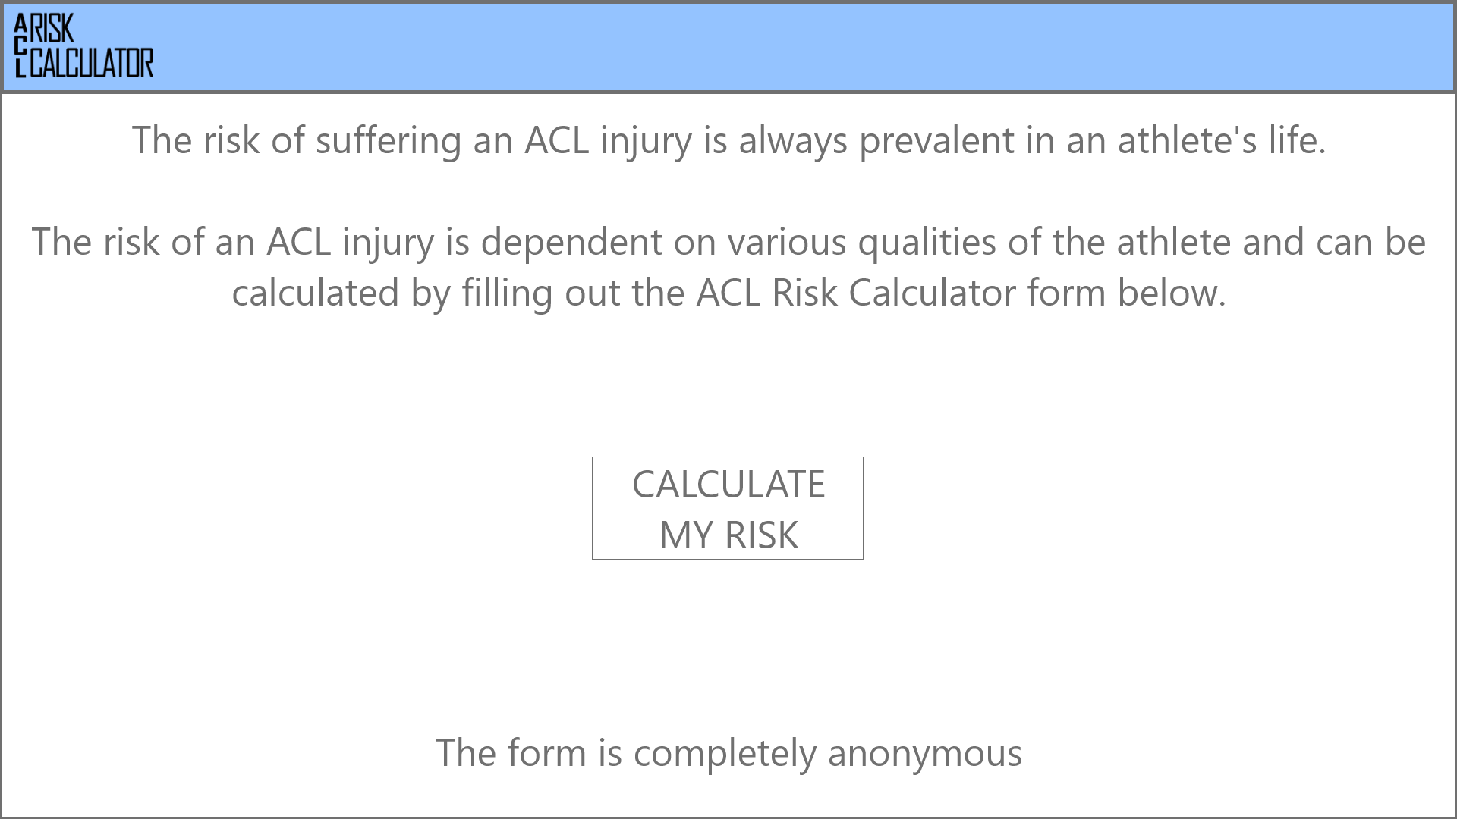
Paper Prototype Views

Slide 6
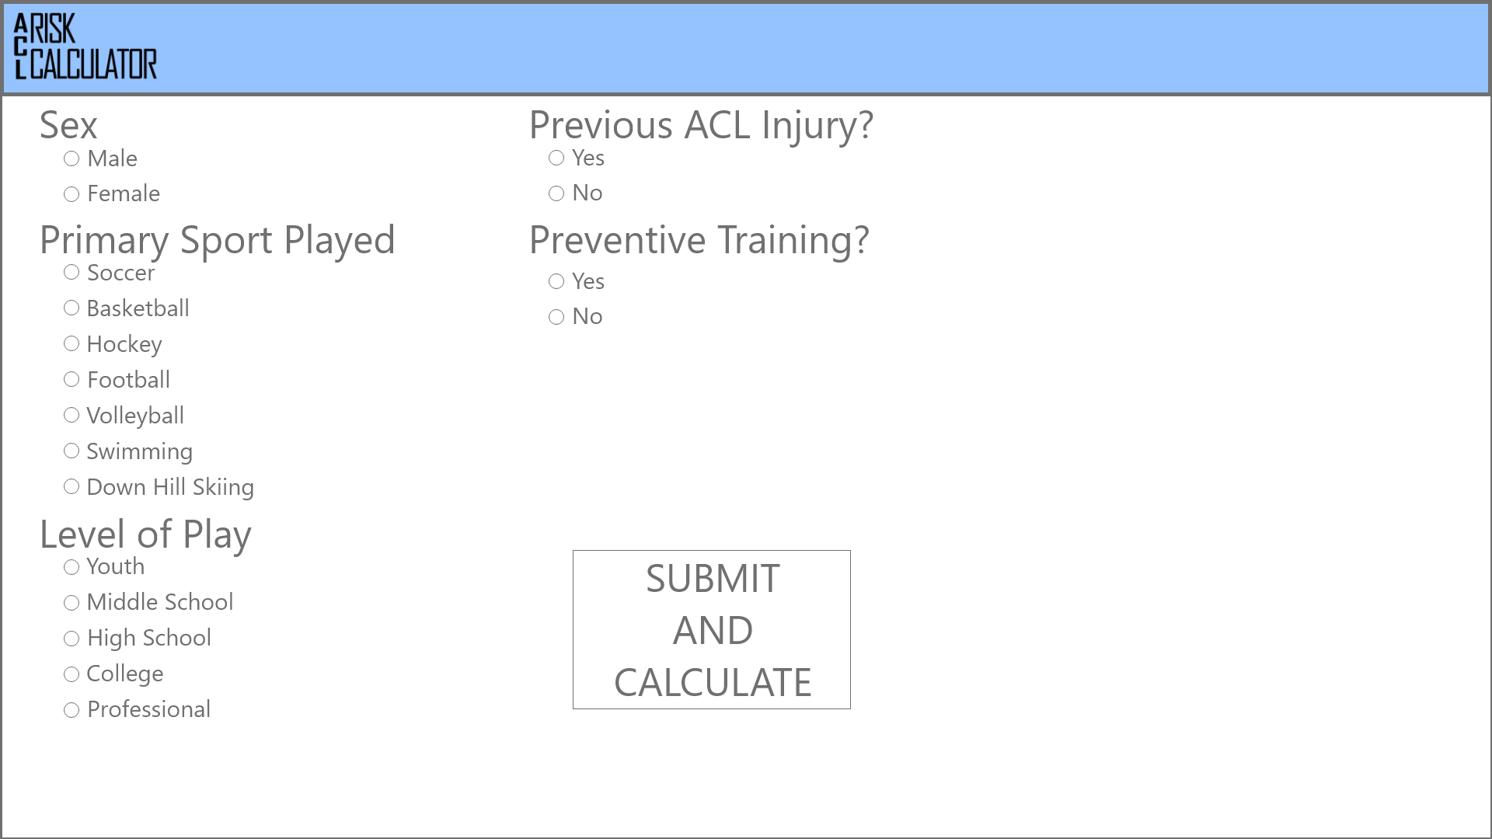
Paper Prototype Views Cont.

Slide 7
Paper Prototype Views Cont.

Slide 8
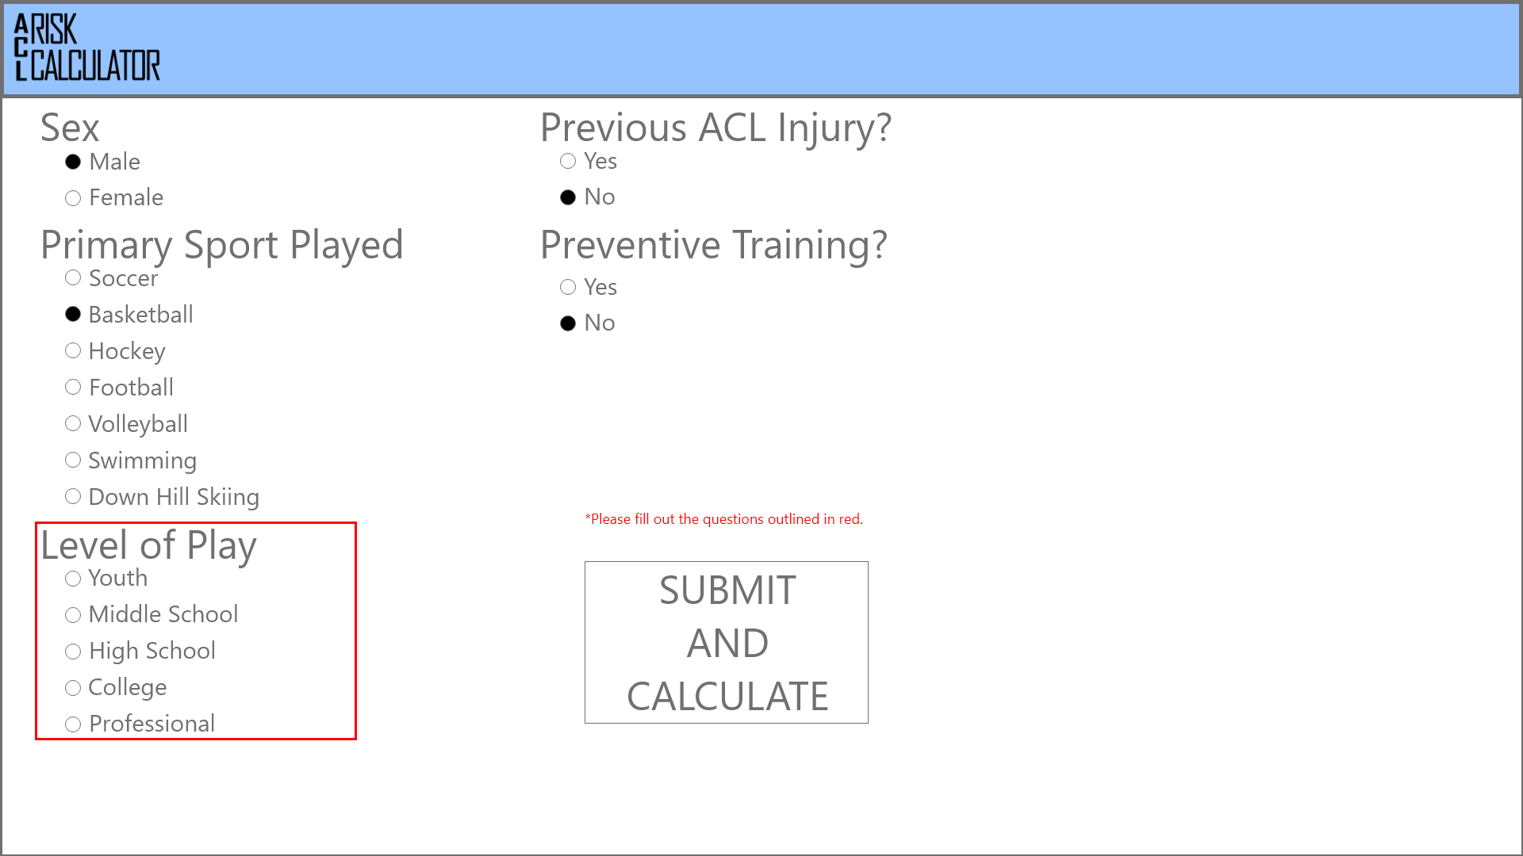
Error Handling Use Scenario

Slide 9
Use Scenario Description
Error Handling
By making all questions required, we can ensure that users fill out all data. If a question is left unanswered, they cannot continue and will be told to answer it. If the form closes unexpectedly it will not save any information. If we integrate with Qualtrics successfully there will need to be error handling on passing the data back. If it fails, the data won’t be sent and the user may have to fill out the information again on a Qualtrics form.

Slide 10
Usability Goals & Concerns
Goals:
Utility: Be able to accurately portray the user’s risk for suffering injury to their ACL based on their answers to the survey.
Efficiency: The user should be able to easily and accurately input their answers to the questions.
Concerns:
Accessibility: The form will be a “readable size” for most, but may be hard to read for those with poor eyesight.

Slide 11
Preliminary Instructional
Users will navigate through a form answering various questions. These questions will have different ways of answering such as check boxes, drop downs, integer type boxes, and short answer type boxes. After the user inputs the requested data the application will then calculate how high their risk is of suffering an ACL injury. The layout and input should be easy enough for people of a younger audience to follow and understand, since these people are the primary audience, however, parents of these people should also be able to find this easy to follow and understand.

Slide 12
Content Recommendations
Multiple displays of the risk assessment (charts, graphs, percentiles)
Links to sites for prevention or next steps for treatment
Multiple UI designs for the form (font increase, background / text color)

